Slide 1
Derivations
Before The Patent Trial and Appeal Board
Thomas L. Giannetti
Administrative Patent Judge
USPTO
March 22, 2013

Slide 2
Trial Structure
Same basic structure for all the proceedings
Reduction of burdens on the parties via:
  Streamlining and converging issues for decision
  Use of page limits and electronic filing (PRPS)
  Use of conference calls

Slide 3
Trial Rules
Umbrella Trial Rules
§§ 42.1 – 42.80
Inter Partes Review
§§ 42.100 – 42.123
Post-Grant Review
§§ 42.200 – 42.224
Covered Business Method Patent Review
§§ 42.300 – 42.304
Derivation Proceeding
Proposed §§ 42.400 – 42.412

Slide 4
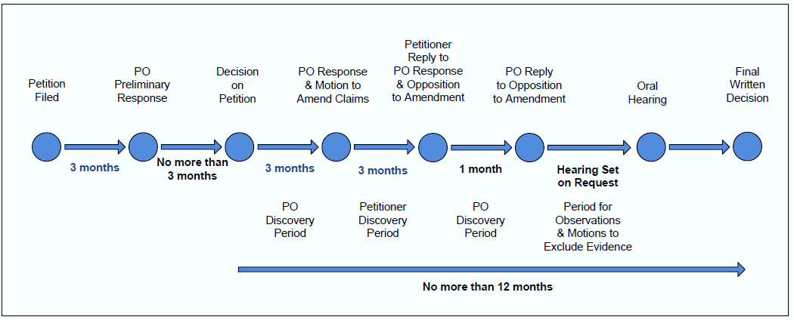
Trial Proceedings
PO = Patent Owner

Slide 5
A Derivation is Not An Interference
No count
Requires a petition
Different rules apply
Only an applicant may file
Must prove earlier applicant derived it

Slide 6
Some Differences Between Derivations and Other AIA Proceedings
Petitioner must have a pending application
Respondent may have a pending application or a patent
Preliminary responses not permitted
Section 146 review option with derivations
Patentability addressed “for good cause”

Slide 7
Petition Requirements
Standing
Claimed invention was derived
Invention claimed by respondent must be “same or substantially the same” as invention disclosed to respondent
Claim construction

Slide 8
Standing
Petitioner’s claim same or substantially the same as invention disclosed
Petitioner’s claim same or substantially the same as invention claimed by respondent
“Same or substantially the same” means patentably indistinct

Slide 9
Sufficiency of Showing
Affidavit showing of communication and lack of authorization
Corroboration of communication
Substantial evidence required

Slide 10
Timing
One-year time bar (after H.R. 6621)
Triggered by earlier of two events:
  Patent granted on earlier application
  First publication of earlier application
  (includes publication of an international application designating the U.S.)
No proceeding until petitioner’s claim is in condition for allowance

Slide 11
Top Petition Requirements
Fee paid
Petitioner’s application identified
Respondent’s earlier patent/application identified
Certificate of service

Slide 12
Procedure After Filing
Petition is reviewed
Filing date accorded
Order returns jurisdiction to Examiner
Claims in condition for allowance absent derivation
Board determines whether to institute

Slide 13
Settlement
Written agreement must be filed with Board
Parties may request confidential treatment
Board must take action unless inconsistent with evidence

Slide 14
Judgment
Written decision required
Adverse decision to application: a “final refusal” 35 U.S.C. 135(d)
Adverse decision to patent: cancels affected claims, noted on patent
Parties may arbitrate
Board may correct inventorship

Slide 15
AIA Help
1-855-HELP-AIA (1-855-435-7242)
HELPAIA@uspto.gov
www.uspto.gov/AmericaInventsAct
www.uspto.gov/ip/boards/bpai

