Slide 1
Preissuance Submissions Under the
America Invents Act
Janet Gongola
Patent Reform Coordinator
Janet.Gongola@uspto.gov
Direct dial: 517-272-8734
Notes:
Good afternoon I am pleased to have the opportunity to discuss with you new provisions of the AIA that will be going into effect on September 16, 2012—the one-year anniversary of the AIA.
Thank you to Barbara Gunderson for organizing this webinar today and for her kind introduction.
When President Obama signed the America Invents Act into law, he aimed to modernize America’s patent laws, reduce the backlog of unexamined patent applications, spur innovation, grow our economy, and create good jobs
With seven AIA provisions going into effect on September 16, we steadily are moving forward to accomplishing President Obama’s objectives.

Slide 2
General Information
Statutory basis: 35 U.S.C. 122(e)
Regulatory basis: 37 C.F.R. 1.290
  Changes to Implement the Preissuance Submissions by Third Party Provisions of the Leahy-Smith America Invents Act: Final Rule,
  77 Fed. Reg. 42150 (July 17, 2012)
Effective: September 16, 2012

Slide 3
Applicability
  May be filed in pending or abandoned utility, design, and plant applications filed before, on, or after September 16, 2012
  May not be filed in issued patents, reissue applications, or reexamination proceedings

Slide 4
The Basics
Any third party may submit printed publications for consideration and inclusion in the record of the application
Submission must:
  be timely;
  made in writing; and
  include concise description of asserted relevance of each document, fee, and statement of compliance with statute

Slide 5
Printed Publications
Submissions are limited to “printed publications”
Publications cumulative to those submitted by the applicant may be submitted
Printed Publication Examples | NOT Printed Publications
U.S. or foreign patent | Confidential internal memo
U.S. or foreign patent application publication | Court document subject to protective order
Non-patent literature --journal article --Office action

Slide 6
Statutory Time Periods
Must be made before the later of:
  6 months after the date on which the application is first published by the Office; or
  date of first rejection of any claim by the examiner
AND
Must be made before the date a notice of allowance is given or mailed

Slide 7
Time Period: Example
Appl.
Filed
18 mos.
Publication
24 mos.
Six months
after Pub.
25 mos.
*First Rej.
33 mos.
Notice of Allowance
* Third-party submission must be filed before this date

Slide 8
Filing of Submission
May be submitted electronically via EFS-Web or in paper but not by facsimile
  Guide for electronic filing available on AIA
  micro-site
  http://www.uspto.gov/patents/process/file/efs/index.jsp
No service on applicant required
  Applicant notified if subscribe to e-Office Action

Slide 9
Filing Date
Submission is filed as of its date of receipt by the Office
Certificate of mailing or transmission provisions do not apply
Third party notified if submission is not compliant if third party provides email address with submission

Slide 10
Contents of Submissions
Document list
  Generated by EFW-Web for electronic submissions
  Form available for paper submissions
    http://www.uspto.gov/forms
Concise descriptions of relevance
Copies of documents, but not for U.S. patents and U.S. patent application publications
Translations for any non-English language documents

Slide 11
Contents of Submissions (cont.)
Statements:
  compliance with statute and rule;
  submitting party does not have a duty of disclosure for the application; and
  “first and only” submission (if fee exemption applies)
Fee (if necessary)
Signed by submitter, but real party in interest need not be identified

Slide 12
Concise Description of Relevance
  Statement of facts explaining how the document is of potential relevance to the examination of the application
Third party should not use the concise description to:
  propose rejections; or
  raise arguments related to an Office action or an applicant’s response

Slide 13
Concise Description of Relevance: Example
Compliant | Non-compliant
Publication X and Publication Y both disclose machines that perform the same function as the machine recited in claim 1. In the first embodiment depicted in Figure 2 and discussed on page 5, the machine of publication X expressly includes element A of claim 1. See lines 7-14 on page 5 of publication X. Publication Y teaches a machine having element B of claim 1. See lines 1-3 on page 6 of publication Y. | Same with the following concluding sentence: Accordingly, claim 1 is obvious in view of the combination of Publication X and Publication Y.

Slide 14
Fee
Service | Fee
Every 10 documents listed or fraction thereof | $180 fee
First submission of 3 or fewer total documents submitted | No fee

Slide 15
Fee: Examples
Third party submits 4 printed publications: cost is $180
Third party submits 14 printed publications: cost is $360

Slide 16
Processing
USPTO Reviews Submission for Compliance with
35 U.S.C. § 122(e) and § 1.290
Submission Made of Record and Considered by Examiner
Patent Applicant Notified if E-Office Action Participant
Compliant
Non-compliant
Submission Discarded
Third Party Notified if Email Address
Available

Slide 17
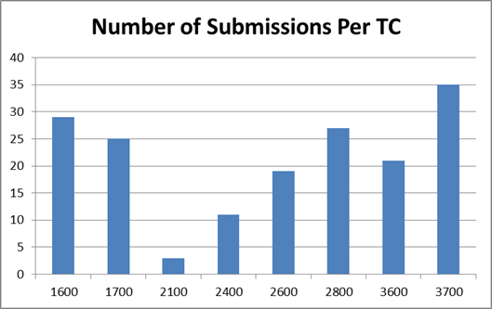
Preissuance Submission: Statistics
(Data as of November 19, 2012)
Status | Number
Proper | 112
Improper | 53
Not Yet Reviewed | 11
TOTAL | 176

Slide 18
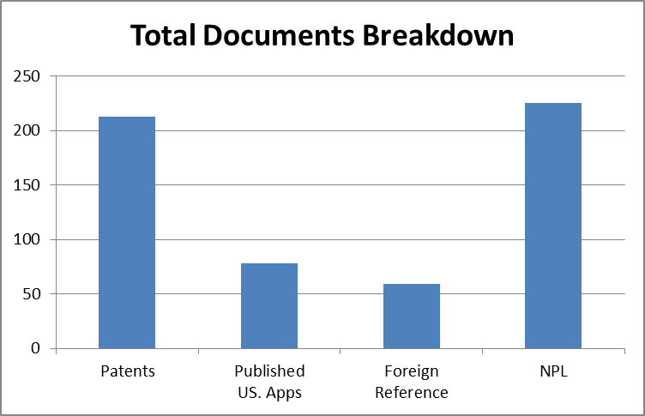
Preissuance Submission: Statistics
(Data as of November 19, 2012)
Printed Publication | Number
Patent | 213
Published U.S. Applications | 48
Foreign Reference | 36
Non-patent literature | 143
TOTAL | 377

Slide 19
Best Practices
Concise description of relevancy must explain factually how printed publication is of potential relevance to the examination of the application
File electronically via the third-party submissions interface in EFS-Web
Check for timeliness before filing
List each printed publication for consideration separately
Provide a complete citation for each printed publication listed
Notes:
1) File a third-party submission electronically using the Office's dedicated interface for third-party submissions, which can be accessed via EFS-Web. Paper submissions experience processing delays due to the scanning and indexing of these papers by the Office.
2) Check whether a third-party submission is timely. A third-party submission cannot be filed if the first rejection has been issued and the application has been published for six months or more. A third-party submission cannot be filed if a notice of allowance has already been issued in the application.
3) Do list each document submitted for consideration separately on the Form PTO/SB/429. Documents identified as "exhibits" or "attachments" that were not published as exhibits or attachments to a listed publication must be listed separately for consideration, unless they are being submitted solely as evidence of publication. What we've seen is some third parties listing a publication and submitting a copy of the publication with "attachments" or "exhibits" that are not part of the original publication. The attachments or exhibits are separate publications and must be listed separately for consideration on the form PTO/SB/429. In other words, a third party cannot circumvent the fee requirement by only listing one publication and uploading a copy of the listed publication with copies of other attached publications that are not also listed.
Not listing an attached publication would only be permitted where the attached publication is being provided solely to establish evidence of publication.
Do provide a complete citation for each publication listed. At a minimum, provide the title and the publication date and/or date retrieved. For a website publication, provide the URL of the website.
Concise description of relevance must factually explain how printed publication bears on patentability.

Slide 20
Pitfalls to Avoid
Do not submit follow-on papers via the preissuance submission interface in EFS-Web
Do not forget fee to resubmit a submission after receiving a non-compliance notification
Notes:
1) Don't file a third-party submission in a provisional application. Third-party submissions may be filed in non-provisional utility, design and plant applications. Third-party submissions may not be filed in provisional applications, reissue applications, or reexamination proceedings.
2) Don't submit documents which have not been published. Don't submit internal corporate documents. Don't submit e-mail correspondence which has not been widely disseminated to the public (e.g., through a blast message to a trade organization).
3) Don't combine copies of publications with the concise description of relevance. Copies of publications should be uploaded separate from the concise description of relevance using the "Foreign Reference" and/or "Non Patent Literature" document descriptions.
4) Don't submit follow-on papers in an application via the third-party submissions interface in EFS-Web. Applicants who are not Registered e-filers cannot submit follow-on papers (e.g., a response to a Notice to File Missing Parts) via EFS-Web.
5) Pay the fee to resubmit a third-party submission after receiving a notification of non-compliance. The fee for a resubmission containing three or fewer documents is $180, even if the fee exemption applied to the earlier, non-compliant submission.

Slide 21
Preissuance Submission Services
Patent Stack Exchange
  Uses crowd sourcing to collect potential printed publications
  http://patents.stackexchange.com/
Commercial vendors
  IP.com
  Patronus
    http://gary-gerttula.squarespace.com/pre-issuance-tracking-and-submissions/

Slide 22
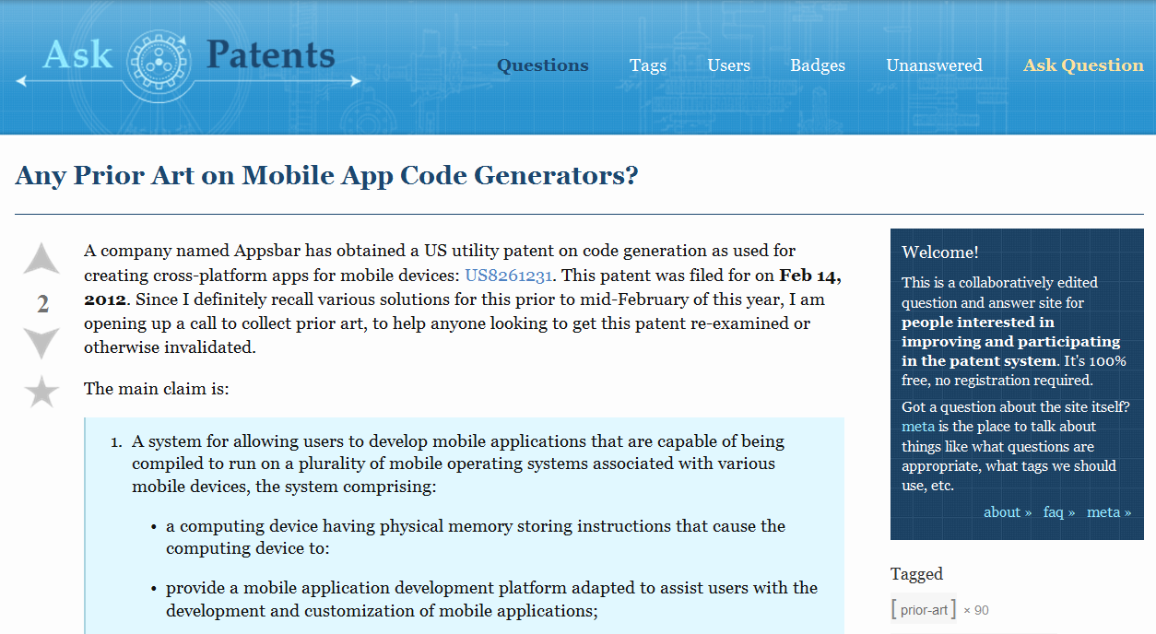
Patent Stack Exchange: Example

Slide 23
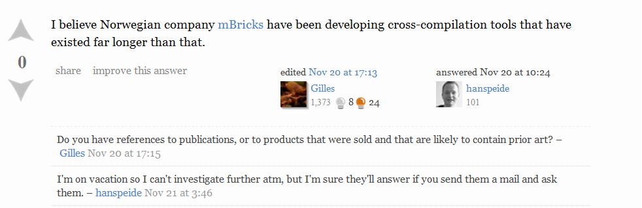
Patent Stack Exchange: Example

Slide 24
AIA Help
1-855-HELP-AIA (1-855-435-7242)
HELPAIA@uspto.gov
www.uspto.gov/AmericaInventsAct

Slide 25
Thank You
Janet Gongola
Patent Reform Coordinator
Janet.Gongola@uspto.gov
Direct dial: 517-272-8734

