Slide 1
The America Invents Act: Modernizing U.S. Patent Law
February 7 and 8, 2013
Janet Gongola
Patent Reform Coordinator
Janet.Gongola@uspto.gov
Direct dial: 517-272-8734

Slide 2
Goals of America Invents Act
Encourage innovation and job creation
Support USPTO’s efforts to improve patent quality and reduce backlog
Establish secure funding mechanism
Provide greater certainty for patent rights
Provide less costly, time-limited administrative alternatives to litigation

Slide 3
USPTO Implementation Principles
Joint effort with patent community
Transparency in rulemaking

Slide 4
Overview
First-inventor-to-file
Prioritized Examination
Preissuance Submissions
Administrative Trials

Slide 5
First-Inventor-to-File
Effective March 16, 2013
Changes to Implement the First Inventor to File Provisions of the Leahy-Smith America Invents Act, 77 Fed. Reg. 43742 (July 26, 2012)
Examination Guidelines for Implementing the First-Inventor-to-File Provisions of the Leahy-Smith America Invents Act , 77 Fed. Reg. 43759 (July 26, 2012)

Slide 6
Statutory Framework
Prior Art | Exceptions
102(a)(1) Public Disclosures | 102(b)(1) | (A) Grace Period Inventor and Non-Inventor Disclosures
 |  | (B) Grace Period Intervening Disclosures
102(a)(2) Prior Filed U.S. Patents, U.S. Patent Applications, and WIPO Published Applications | 102(b)(2) | (A) Non-inventor Disclosures
 |  | (B) Intervening Disclosures
 |  | (C) Commonly Owned Disclosures

Slide 7
AIA Impact on Old 35 U.S.C. 102
Pre-AIA 35 U.S.C. 102 A person shall be entitled to a patent unless— | AIA 35 U.S.C. 102 Correspondence
(a) the invention was known or used by others in this country, or patented or described in a printed publication in this or a foreign country, before the invention thereof by the applicant for patent, or | 102(a)(1)
(b) The invention was patented or described in a printed publication in this or a foreign country or in public use or on sale in this country, more than one year prior to the date of the application for patent in the United States, or
(c) He has abandoned the invention, or | No corresponding provision
(d) The invention was first patented or caused to be patented, or was the subject of an inventor’s certificate, by the applicant or his legal representatives or assigns in a foreign country prior to the date of the application for patent in this country on an application for patent or inventor’s certificate filed more than twelve months before the filing date of the application in the United States, or
(e) The invention was described in An application for patent, published under section 122(b), by another filed in the United States before the invention by the applicant for patent or A patent granted on an application for patent by another filed in the United States before the invention by the applicant for patent, except than an international application filed under the treaty defined in section 351(a) shall have the effects for the purposes of this subsection of an application filed in the United States only if the international application designated the United States and was published under Article 21(2) of such treaty in the English language, or | 102(a)(2)
(f) He did not himself invent the subject matter sought to be patented, or | 101 and 115
(g) during the course of an interference conduced under section 135 or section 291, another inventor involved therein establishes, to the extent permitted in section 104, that before such person’s invention thereof the invention was made by such other inventor and not abandoned, suppressed, or concealed, or Before such person’s invention thereof, the invention was made in this country by another inventor who had not abandoned, suppressed, or concealed it. | No corresponding provision
Abandonment of invention
Premature foreign patenting
Derivation
Prior invention by another

Slide 8
35 U.S.C. 102(a)(1): Prior Art
Precludes a patent if a claimed invention was, before the effective filing date of the claimed invention:
  Patented;
  Described in a Printed Publication;
  In Public Use;
  On Sale; or
  Otherwise Available to the Public
Generally corresponds to the categories of prior art in
pre-AIA 35 U.S.C. 102(a) and 35 U.S.C. 102(b)

Slide 9
“Effective Filing Date”
35 U.S.C. 100(i)(1) defines “effective filing date”
Effective filing date:
  actual filing date of the patent or published application containing the claimed invention, or
  filing date to which the patent or published application is entitled to claim a right of priority or benefit under 35 U.S.C. 119, 120, 121, or 365 as to such claimed invention

Slide 10
In Public Use or On Sale
Eliminated pre-AIA geographic limitation; use or sale may occur anywhere in the world
Public input sought on whether secret sales eligible to be prior art

Slide 11
Proposed: “Otherwise Available to the Public”
Introduced by the AIA; no corresponding language in pre-AIA 35 U.S.C. 102
Catch-all to account for other means of making an invention publicly available
Notes:
E.g., poster displayed at a scientific meeting, document electronically posted on the Internet

Slide 12
35 U.S.C. 102(b)(1)(A): Grace Period Inventor & Non-inventor Disclosure Exception
First exception for prior art under 35 U.S.C. 102(a)(1) found in 35 U.S.C. 102(b)(1)(A)
A disclosure made one year or less before the effective filing date of the claimed invention shall not be prior art under
35 U.S.C. 102(a)(1) if:
    the disclosure was made by:
      the inventor or joint inventor; or
      another who obtained the subject matter directly or indirectly from the inventor or joint inventor

Slide 13
35 U.S.C. 102(b)(1)(B): Grace Period Intervening Disclosure Exception
Second exception for prior art under 35 U.S.C. 102(a)(1) found in 35 U.S.C. 102(b)(1)(B)
A disclosure made one year or less before the effective filing date of the claimed invention shall not be prior art under
35 U.S.C. 102(a)(1) if:
    the subject matter disclosed was, before such disclosure, publicly disclosed by:
      the inventor or joint inventor; or
      another who obtained the subject matter directly or indirectly from the inventor or joint inventor

Slide 14
“One Year or Less”
AIA grace period measured from the filing date of the earliest U.S. or foreign patent application to which a benefit/priority claim is made
Pre-AIA grace period measured from the filing date of the earliest application filed in the U.S. directly or via PCT

Slide 15
Proposed: “The Subject Matter”
Subject matter in the prior disclosure must be the same as that later publicly disclosed for the exception to apply
Mere insubstantial changes or trivial/obvious variations in subject matter are not covered
Mode of disclosure by inventor need not be the same as the mode of disclosure for the intervening grace period disclosure
No requirement for verbatim disclosures

Slide 16

35 U.S.C. 102 (a)(1) & (b)(1): Shorthand
Provision | Function | Language
102(a)(1) | Creates prior art | Invention publicly disclosed before the effective filing date of the claimed invention via: Patent Printed Publication Sale Public Use Otherwise available to the public
102(b)(1) | Gives 2 exceptions to prior art | Not prior art if the invention was publicly disclosed one year or less before the effective filing date of the claimed invention by (i) inventor; (ii) joint inventor; or (iii) by another who obtained the subject matter directly or indirectly from either the inventor or joint inventor; or Not prior art if INVENTOR disclosed the subject matter before third party’s public disclosure and INVENTOR’S disclosure was one year or less before the effective filing date of the claimed invention
Public Disclosures
Grace Period Inventor and Non-inventor Disclosures
Grace Period Intervening Disclosures

Slide 17
Example 1
A’s Grace Period
July 15, 2013
July 15, 2014
A publishes X
A files patent application
claiming X
A’s publication is prior art under 102 (a)(1), but knocked out by the exception in 102(b)(1)(A) as a grace period inventor disclosure

Slide 18
Example 2
A’s Grace Period
July 15, 2013
July 15, 2014
A publishes X
B publishes X
A files patent application
claiming X
B’s publication is prior art under 102(a)(1), but knocked out by the exception in 102(b)(1)(B) as a grace period intervening disclosure
A’s publication is prior art under 102 (a)(1), but knocked out by the exception in 102(b)(1)(A) as a grace period inventor disclosure

Slide 19
Example 3
A’s Grace Period
July 15, 2013
July 15, 2014
A publishes X
B publishes X and Y
A files patent application
claiming X
B’s publication is prior art under 102(a)(1), but knocked out by the exception in 102(b)(1)(B) as grace period intervening disclosure as to subject matter X only.
B’s publication is prior art as to subject matter Y per proposed rule
A’s publication is prior art under 102 (a)(1), but knocked out by the exception in 102(b)(1)(A) as grace period inventor disclosure

Slide 20
35 U.S.C. 102(a)(2): Prior Art
Precludes a patent if a claimed invention was described in a:
  U.S. Patent;
  U.S. Patent Application Publication; or
  WIPO publication of PCT Application designating the U.S. (aka WIPO Published Application)
  that names another inventor and was effectively filed before the effective filing date of the claimed invention
Generally corresponds to the categories of prior art in pre-AIA 35 U.S.C. 102(e)

Slide 21
WIPO Published Applications
Eliminated pre-AIA requirement that WIPO published applications are treated as prior art only if:
  (i) filed on or after November 29, 2000;
  and
  (ii) published in English

Slide 22
“Names Another Inventor”
Requirement to names another inventor is satisfied if there is any difference in inventive entity between:
  (i) prior art U.S. patent, U.S. patent application publication; or WIPO published application
  and
  (ii) application under examination

Slide 23
“Effectively Filed”
35 U.S.C. 102(d) defines “effectively filed”
Effective prior art date of subject matter in U.S. patents and published applications under AIA 35 U.S.C. 102(a)(2) is:
  actual filing date of the U.S. patent or published application
  or
  date to which the U.S. patent or published application is entitled to claim a right of priority or benefit under 35 U.S.C. 119, 120, 121, or 365 which describes the subject matter

Slide 24
35 U.S.C. 102(b)(2)(A): Non-inventor Disclosure Exception
First exception for prior art under 35 U.S.C. 102(a)(2) found in 35 U.S.C. 102(b)(2)(A)
A disclosure in an application or patent shall not be prior art under 35 U.S.C. 102(a)(2) if:
    the disclosure was made by another who obtained the subject matter directly or indirectly from the inventor or joint inventor

Slide 25
35 U.S.C. 102(b)(2)(B): Intervening Disclosures Exception
Second exception for prior art under 35 U.S.C. 102(a)(2) found in U.S.C. 102(b)(2)(B)
A disclosure in an application or patent shall not be prior art under 35 U.S.C. 102(a)(2) if:
    the subject matter disclosed was, before such subject matter was effectively filed, publicly disclosed by:
      the inventor or joint inventor; or
      another who obtained the subject matter directly or indirectly from the inventor or joint inventor

Slide 26
35 U.S.C. 102(b)(2)(C): Commonly Owned Disclosure Exception
Third exception for prior art under 35 U.S.C. 102(a)(2) found in 35 U.S.C. 102(b)(2)(C)
A disclosure made in an application or patent shall not be prior art under 35 U.S.C. 102(a)(2) if:
    the subject matter and the claimed invention were commonly owned or subject to an obligation of assignment to the same person not later than the effective filing date of the claimed invention
Resembles pre-AIA 35 U.S.C. 103(c), but AIA disqualifies art for both novelty and obviousness whereas pre-AIA disqualified art only for obviousness

Slide 27
Commonly Owned or Subject to Assignment
Applicant can establish common ownership or obligation of assignment by making a clear and conspicuous statement
Corroborating evidence is not required

Slide 28
35 U.S.C. 102 (a)(2) & (b)(2): Shorthand
Provision | Function | Language
102(a)(2) | Creates prior art | Invention was effectively filed by third party before the effective filing date of the claimed invention by inventor: U.S. Patents U.S. Patent Application Publications WIPO Publications
102(b)(2) | Gives 3 exceptions prior art | Not prior art if earlier disclosure made by third party who obtained the subject matter directly or indirectly from either the inventor or joint inventor Not prior art if INVENTOR disclosed the subject matter before another effective filing date Not prior art if subject matter disclosed by a third party and the claimed invention were commonly owned or subject to an obligation of assignment to the same person not later than the effective filing date of the claimed invention
Prior Filed U.S. Patents, U.S. Patent Applications, and WIPO Published Applications
Non-inventor Disclosures
Intervening Disclosures
Commonly Owned Disclosures

Slide 29
Example 4
June 15, 2014
July 15, 2014
B files patent application claiming X
A files patent application
claiming X
B’s patent application is prior art under 102 (a)(2), but knocked out by the exception in 102(b)(2)(A) as a non-inventor disclosure if non-inventor B obtained X from inventor A

Slide 30
Example 5
January 15, 2014
June 15, 2014
July 15, 2014
A publishes
on X
B files patent application claiming X
A files patent application
claiming X
B’s patent application is prior art under 102 (a)(2), but knocked out by the exception in 102(b)(2)(B) as an intervening disclosure
A’s publication is prior art under 102 (a)(1), but knocked out by the exception in 102(b)(1)(A) if made within the grace period

Slide 31
Example 6
January 15, 2014
June 15, 2014
July 15, 2014
A publishes
on X
B files patent application claiming
X and Y
A files patent application
claiming X
B’s patent application is prior art under 102 (a)(2), but knocked out by the exception in 102(b)(2)(B) as an intervening disclosure for subject matter X. B’s patent application is prior art as to subject matter Y per proposed rule
A’s publication is prior art under 102 (a)(1), but knocked out by the exception in 102(b)(1)(A) if made within the grace period

Slide 32
Example 7
March 15, 2014
May 15, 2014
June 15, 2014
July 15, 2014
A invents X and assigns to Company
B invents X and assigns to Company
B files patent application
claiming X
A files patent application
claiming X
B’s patent application is prior art under 102 (a)(2), but knocked out by the exception in 102(b)(2)(C) as a commonly owned disclosure

Slide 33
Proposed: Affidavit/Declaration of Attribution
37 C.F.R. 1.130(a): used to disqualify prior art because it was made by the inventor or a joint inventor
Taps exception in 102(b)(1)(A)

Slide 34
Proposed: Affidavit/Declaration of Prior Public Disclosure
37 C.F.R. 1.130(b): used to disqualify prior art because inventor disclosed subject matter before the disclosure or effective filing date of the subject matter on which the rejection was based
Taps exception in 102(b)(1)(B) and 102(b)(2)(B)

Slide 35
Proposed: Affidavit/Declaration of Origination from Inventor
37 C.F.R. 1.130(a): used to disqualify prior art because the disclosure was made, or the subject matter had been previously publicly disclosed, by another who obtained it from the inventor
Taps exception in 102(b)(1)(A), 102(b)(1)(B), 102(b)(2)(A), and 102(b)(2)(B)

Slide 36
Proposed: Affidavit/Declaration Not Available
Rejection is based on disclosure made more than 1 year before effective filing date of claimed invention;
and
Contention that inventor named in prior art U.S. patent or U.S. patent application publication derived the claimed invention

Slide 37
Applicability of New 102
AIA 35 U.S.C. 102 and 103 will apply to an application or patent that contains or contained at any time:
  a claim having an effective filing date that is on or after March 16, 2013;
  or
  a benefit claim under 35 U.S.C. 120 (continuation), 121 (divisional), or 365(c) (U.S. national or international) to an application that contains or contained at any time a claim having an effective filing date on or after March 16, 2013

Slide 38
Applicability of Old and New 102 and 103
Pre-AIA 35 U.S.C. 102(g) and AIA 35 U.S.C. 102 and 103 will apply to an application that contains or contained at any time:
  a claim having an effective filing date before March 16, 2013, or a benefit claim under 35 U.S.C. 120 (continuation), 121 (divisional), or 365(c) (U.S. national or international) to an application that contains or contained at any time a claim having an effective filing date before March 16, 2013
  and
  a claim having an effective filing date that is on or after March 16, 2013

Slide 39
Proposed: AIA Statement
For nonprovisional applications that are:
  filed on or after March 16, 2013; and
  claim priority/benefit of a foreign, provisional, or nonprovisional application filed before March 16, 2013,
    applicant must indicate if the application contains, or contained at any time, a claim having an effective filing date on or after March 16, 2013
Applicant is not required to identify how many or which claims have an effective filing date on or after March 16, 2013
AIA statement must be filed for an application within specific time window

Slide 40
Prioritized Examination
Effective September 26, 2011
Changes To Implement the Prioritized Examination Track (Track I) of the Enhanced Examination Timing Control Procedures Under the Leahy-Smith America Invents Act, 76 Fed. Reg. 59050 (September 23, 2011)
Changes To Implement the Prioritized Examination for Requests for Continued Examination, 76 Fed. Reg. 78566 (December 19, 2011)

Slide 41
Features
Available for utility, plant, and continuing patent applications and requests for continued examination
  Not available for international, design, reissue, or provisional applications or in reexamination proceedings
Requirements:
  no more than 4 independent claims, 30 total claims, and no multiple dependent claims; and
  electronically file(utility application); and
  pay fee
Fee September 16, 2012 to March 18, 2013 | Fee Starting March 19, 2013
$ 4,800 | $ 4,000

Slide 42
Final Disposition
USPTO goal for final disposition is on average 12 months from date of prioritized status
Prioritized exam is terminated without a refund of prioritized exam fee if patent applicant:
  petitions for an extension of time to file a reply or to suspend action; or
  amends the application to exceed the claim restrictions

Slide 43
Statistics
(September 16, 2011 through December 20, 2012)
Fiscal Year | Pending | Granted | Dismissed | Total
FY2011 | 3 | 827 | 25 | 1327
FY2012 | 118 | 4610 | 301 | 5027
FY 2103 | 698 | 608 | 21 | 855
Pendency to First Action on Merit from Grant of Request (mos.) | Pendency to Final Disposition from Grant of Request (mos.)
2.0 | 5.32

Slide 44
Preissuance Submissions
Effective September 16, 2012
Changes to Implement the Preissuance Submissions by Third Party Provisions of the Leahy-Smith America Invents Act: Final Rule, 77 Fed. Reg. 42150 (July 17, 2012)

Slide 45
Features
Any third party may submit printed publications for consideration and inclusion in the record of an application
Submission must:
  be timely;
  made in writing; and
  include concise description of asserted relevance of each document, fee, and statement of compliance with statute
  May be filed in pending or abandoned utility, design, and plant applications filed before, on, or after September 16, 2012
    May not be filed in issued patents, reissue applications, or reexamination proceedings

Slide 46
“Printed Publications”
Submissions are limited to “printed publications”
Publications cumulative to those submitted by the applicant may be submitted

Slide 47
Statutory Time Periods
Must be made before the later of:
  6 months after the date on which the application is first published by the Office; or
  date of first rejection of any claim by the examiner
and
Must be made before the date a notice of allowance is given or mailed

Slide 48
Time Period: Example
Appl.
Filed
18 mos.
Publication
24 mos.
Six months
after Pub.
25 mos.
*First Rej.
33 mos.
Notice of Allowance
* Third-party submission must be filed before this date

Slide 49
Filing of Submission
May be submitted electronically via EFS-Web or in paper but not by facsimile
  Guide for electronic filing available on AIA
  micro-site
  http://www.uspto.gov/patents/process/file/efs/index.jsp
Signed by submitter, but real party in interest need not be identified
No service on applicant required
  Applicant notified if subscribe to e-Office Action

Slide 50
Filing Date
Submission is filed as of its date of receipt by the Office
Third party notified if submission is not compliant if third party provides email address with submission

Slide 51
Concise Description of Relevance
  Statement of facts explaining how the document is of potential relevance to the examination of the application
Third party should not use the concise description to:
  propose rejections; or
  raise arguments related to an Office action or an applicant’s response

Slide 52
Concise Description of Relevance: Example
Compliant | Non-compliant
Publication X and Publication Y both disclose machines that perform the same function as the machine recited in claim 1. In the first embodiment depicted in Figure 2 and discussed on page 5, the machine of publication X expressly includes element A of claim 1. See lines 7-14 on page 5 of publication X. Publication Y teaches a machine having element B of claim 1. See lines 1-3 on page 6 of publication Y. | Same with the following concluding sentence: Accordingly, claim 1 is obvious in view of the combination of Publication X and Publication Y.

Slide 53
Fee
Service | Fee
Every 10 documents listed or fraction thereof | $180 fee
First submission of 3 or fewer total documents submitted | No fee

Slide 54
Processing
USPTO Reviews Submission for Compliance with
35 U.S.C. § 122(e) and § 1.290
Submission Made of Record and Considered by Examiner
Patent Applicant Notified if E-Office Action Participant
Compliant
Non-compliant
Submission Discarded
Third Party Notified if Email Address
Available

Slide 55
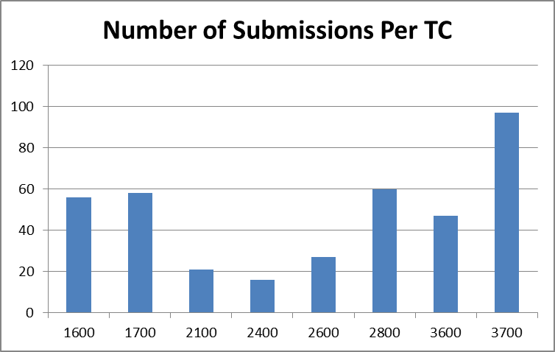
Statistics
(September 16, 2012 to January 25, 2013)
Total 3rd Party Submissions | 390

Slide 56
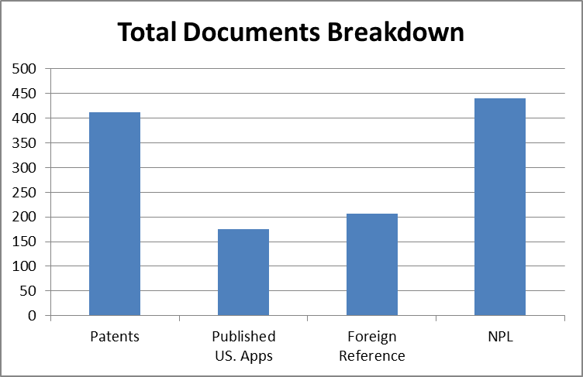
Statistics
(September 16, 2012 to January 25, 2013)
Total Documents
Patents | 412
Published US Apps | 175
Foreign Reference | 206
NPL | 440
Total Documents | 1233

Slide 57
Administrative Trials
Effective September 16, 2012
General Administrative Trial Final Rules, 77 Fed. Reg. 48612 (August 14, 2012)
Trial Practice Guide, 77 Fed. Reg. 48756 (August 14, 2012)
Inter Partes, Post Grant, and Covered Business Method Review Final Rules,
77 Fed. Reg. 48680 (August 14, 2012)

Slide 58
PGR and IPR Features
Proceeding | Petitioner | Petitioner Estoppel | Standard | Basis
Post Grant Review (PGR) | Person who is not the patent owner and has not previously filed a civil action challenging the validity of a claim of the patent Must identify real party in interest | Raised or reasonably could have raised Applied to subsequent USPTO/district court/ITC action | More likely than not OR Novel or unsettled legal question important to other patents/ applications | 101, 102, 103, 112, double patenting but not best mode
Inter Partes Review (IPR) |  |  | Reasonable likelihood | 102 and 103 based on patents and printed publications

Slide 59
PGR and IPR Features (cont.)
Proceeding | Eligible | Available | Timing
Post Grant Review (PGR) | Patent issued under first-inventor-to-file | From patent grant to 9 months from patent grant or reissue | Must be completed within 12 months from institution, with 6 months good cause exception possible
Inter Partes Review (IPR) | Patent issued under first-to-invent or first-inventor-to-file | For September 16, 2012 to January 13, 2013: From the later of: (i) 9 months after patent grant or reissue; or (ii) the date of termination of any post grant review of the patent Starting on January 14, 2013: From patent grant for patents issued under first-to-invent

Slide 60
Process
Patent Owner Preliminary Response
PTAB Decision on Petition
Petition Phase:
Third Party Petition Filed
3 months
3 months
Patent Owner Response/ Claim Amendments
Trial Phase:
Patent Owner Reply
PTAB Final Written Decision
Third Party Reply
Oral Hearing
Scheduling conference at 1 month;
3 months
3 months
1 months
2 months;
Motions to exclude evidence
3 months
Sequenced discovery;
No more than 12 months

Slide 61
Filing a Petition
Use PRPS Electronic Filing System
  https://ptabtrials.uspto.gov/
Users must register before filing any papers
  Registration is only available for practitioners with a USPTO registration number
Quick Start Guide available to walk through filing process
  http://www.uspto.gov/ip/boards/bpai/prps_quick_start_guide.pdf

Slide 62
Contents of Petition
Real parties in interest;
All claims challenged and grounds on which the challenge to each claim is based;
Claim construction and how the construed claim is unpatentable based on the grounds alleged;
Copies of evidence relied upon;
Certification that the petitioner is not estopped from proceeding;
Lead and backup counsel with contact information; and
Fees

Slide 63
Page Limits: Petition, Patent Owner Preliminary Response, and Patent Owner Response
80 pages for PGR
60 pages for IPR
Claim charts included in page count, but single spacing is permitted
Statement of material facts is optional

Slide 64
Motion to Amend
Authorization is not required to file the initial motion to amend, but conferring with the Board is required
May cancel any challenged claim and/or propose a reasonable number of substitute claims
  Additional motion may be authorized for good cause

Slide 65
Types of Discovery
Parties may agree to discovery between themselves
Discovery otherwise divided into 3 types:
  mandatory initial disclosures;
  routine; and
  discretionary

Slide 66
Scope of Discovery
Routine discovery:
  Cited documents;
  Cross-examination for submitted testimony; and
  Information inconsistent with positions advanced during the proceeding
Discretionary discovery by request upon a showing of:
  PGR: Good cause
  IPR: Interests of justice

Slide 67
Supplemental Information
Request for the authorization to file a motion to submit supplemental information must be made within 1 month after institution
Must be relevant to a claim for which the trial has been instituted
Any supplemental information filed later than 1 month after institution must show why the supplemental information reasonably could not have been obtained earlier and that consideration of the information would be in the
interests-of-justice

Slide 68
Settlement
Terminates the proceeding with respect to the petitioner
Board may terminate the proceeding or issue a final written decision

Slide 69
Final Decision and Request for Rehearing
Board will issue a final written decision that addresses the patentability of any claim for which a trial is instituted and any new claim added
Request for rehearing possible:
  14 days of the entry of a non-final decision or a decision to institute a trial; or
  within 30 days of the entry of a final decision or a decision not to institute a trial
Party dissatisfied with the final written decision may appeal to the Federal Circuit

Slide 70
Patent Owner Estoppel
Patent owner is precluded from taking any action inconsistent with an adverse judgment, including:
  Obtaining a claim in any patent that is patentably indistinct from a finally refused or canceled claim; or
  Making an amendment to the specification or a drawing that was denied during the trial, but this provision does not apply to an application or patent that has a different written description

Slide 71
Post Grant Review Fee
Service | Fee September 16, 2012 to March 18, 2013
Petition challenging 20 or fewer claims | $ 35,000
Additional claims challenged in excess of 20 | $800 per claim
Service | Fee Starting March 19, 2013
Petition challenging 20 or fewer claims | $ 12,000
Petition per claim in excess of 20 | $250
Institution of trial for 15 or fewer claims | $18,000
Institution per claim in excess of 15 | $550
TOTAL | $30,000

Slide 72
Inter Partes Review Fee
Service | Fee September 16, 2012 to March 18, 2013
Petition challenging 20 or fewer claims | $ 27,200
Additional claims challenged in excess of 20 | $600 per claim
Service | Fee Starting March 19, 2013
Petition challenging 20 or fewer claims | $ 9,000
Petition per claim in excess of 20 | $200
Institution of trial for 15 or fewer claims | $14,000
Institution per claim in excess of 15 | $400
TOTAL | $23,000

Slide 73
Statistics
(Data as of January 25, 2013)
Administrative trials = 130 petitions
  115 inter partes review
  15 covered business method review
75% electrical; 25% chemical/biotech/mechanical

Slide 74
AIA Help
1-855-HELP-AIA (1-855-435-7242)
HELPAIA@uspto.gov
www.uspto.gov/AmericaInventsAct

Slide 75
Thank You
Janet Gongola
Patent Reform Coordinator
Janet.Gongola@uspto.gov
Direct dial: 517-272-8734

Slide 76
Supplemental Materials

Slide 77
Inventor’s Oath or Declaration
Effective September 16, 2012
Changes to Implement the Inventor’s Oath or Declaration Provisions of the Leahy-Smith America Invents Act: Final Rule, 77 Fed. Reg. 48776 (August, 14, 2012)

Slide 78
35 U.S.C. 118
Permits an assignee, person to whom there is an obligation to assign, or person with a sufficient proprietary interest in the claimed invention to be the applicant
Each inventor must still be named

Slide 79
35 U.S.C. 115
  35 U.S.C. 115 requires for each inventor:
  Oath/declaration executed by the inventor;
  Substitute statement with respect to the inventor; or
  Assignment that contains the statements required for an oath/declaration by the inventor

Slide 80
Inventor’s Oath or Declaration: Requirements
Inventor must identify or state in oath/declaration:
  application to which it is directed;
  person executing the oath/declaration by his or her legal name;
  application was made or was authorized to be made by the person executing the oath/declaration; and
  person executing the oath/declaration believes himself or herself to be the original inventor or an original joint inventor of a claimed invention in the application

Slide 81
Inventor’s Oath/Declaration: Eliminated Requirements
Oath/declaration is no longer required to state:
  Names of all inventors (if provided in an ADS);
  Identification of an inventor’s citizenship;
  That the inventor believes himself or herself to be the “first” inventor; and
  Foreign priority claims (must be provided in an ADS)
  Person making the oath/declaration acknowledges the duty of disclosure and has reviewed and understands the contents of the application

Slide 82
Substitute Statements
Non-inventor applicant may file a substitute statement if an inventor:
  is deceased;
  is legally incapacitated;
  cannot be found or reached after diligent effort; or
  refuses to execute an oath or declaration

Slide 83
Non-Inventor Filer of Substitute Statement
Non-inventor who files a substitute statement is limited to:
  Assignee;
  Obligated assignee; or
  Person with sufficient proprietary interest
No petition required for assignee or obligated assignee
Petition with proof of ownership required for person alleging sufficient proprietary interest

Slide 84
Substitute Statements
Requirements
Identify the person executing the substitute statement and the relationship to the non-signing inventor;
Identify the permitted basis;
  No proof is required to establish that inventor cannot be found after diligent effort or refused to execute
Identify the inventor with respect to whom the statement applies; and
Must contain the statements and information required for an oath/declaration as to the inventor

Slide 85
Assignment Containing Statements: Requirements
Assignment may serve as an oath/declaration if:
  includes the information and statements required for an oath/declaration; and
  copy of the assignment is recorded in the Office’s assignment database
    Applicant may request Office to direct copy of combination assignment-oath/declaration to be placed in application file from assignment database

Slide 86
Timing of Submission
From September 16, 2012 to January 13, 2103: Oath/declaration may be postponed until the application is otherwise in condition for allowance provided that a signed ADS has been submitted:
  identifying each inventor by his or her legal name; and
  with a mailing address and residence for each inventor
Starting on January 14, 2013: oath/declaration required no later than the date on which the issue fee is paid
Current surcharge is still required when the oath/declaration is not present on filing

Slide 87
Application Data Sheet
Required if:
  inventor’s oath/declaration not submitted with application;
  inventor’s oath/declaration not executed by all of the inventors; or
  foreign priority (except national stage application) or domestic benefit claim made
Can be signed by applicant or applicant’s representative

Slide 88
Forms and Guidance Materials
Quick reference guide for how to file an inventor’s oath/declaration available on AIA micro-site:
  http://www.uspto.gov/aia_implementation/inventors-oath-or-declaration-quick-reference-guide.pdf
Tips for substitute statements, correcting inventorship, and filing USPTO forms
  http://www.uspto.gov/blog/aia/
  Includes Inventor’s Oath or Declaration Examples
USPTO forms and instructions for common forms available at: http://www.uspto.gov/forms/
  Oath/declaration
  Substitute statement
  Power of Attorney
  Application data sheet
  No form for combination assignment-statements

Slide 89
Fee Setting
Effective March 19, 2013
Setting and Adjusting Patent Fees, 78 Fed. Reg. 4212 (January 18, 2013)

Slide 90
Fee Setting Goals and Strategies
Ensure the patent fee schedule generates sufficient aggregate revenue to recover the aggregate cost to:
  Optimize patent timeliness and quality; and
  Implement a sustainable funding model
Set individual fees to:
  Foster innovation;
  Facilitate the effective administration of the patent system; and
  Offer patent prosecution options to applicants

Slide 91
Optimize Patent Timeliness
Reduce total pendency by more than 11 months during a five-year period
(FY 2013 to FY 2017)
XX.X
Average End-of-Year First Action Pendency,
in Months
XX.X
Average End-of-Year Total Pendency,
in Months

Slide 92
Optimize Patent Quality
Permit the Office to continue improving patent quality through:
  Comprehensive training for examiners;
  Expanded and enhanced Ombudsman program;
  Reengineering the examination process;
  Guidelines for examiners to address clarity in patent applications; and
  Encouraging and facilitating examiner-applicant interviews

Slide 93
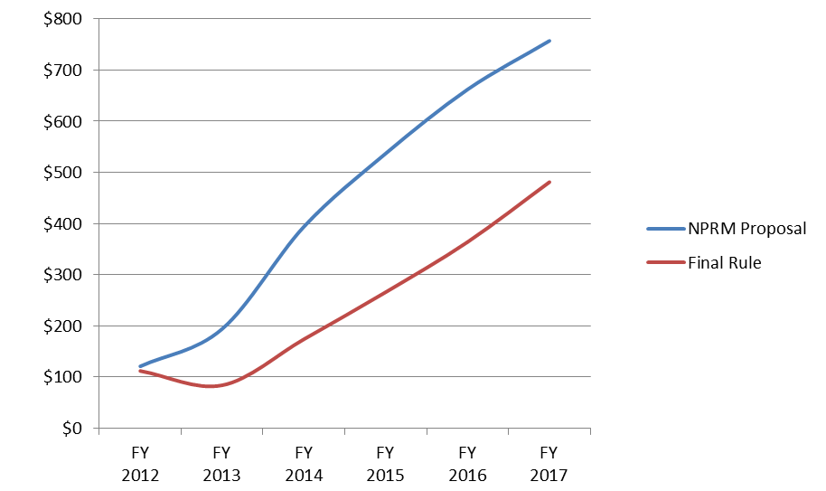
Sustainable Funding Model
Continue building an operating reserve of three months of operating expenses by FY 2018
Description | FY 2013 | FY 2014 | FY 2015 | FY 2016 | FY 2017
3 Months Operating Expense | $633 M | $685 M | $701 M | $713 M | $704 M
Estimated End of Year Balance | $84 M | $174 M | $266 M | $364 M | $481 M
Over/(Under) Target Balance | ($549 M) | ($511 M) | ($435 M) | ($349 M) | ($223 M)
Annual Cost: Deposit to/(Use of) the Operating Reserve | ($28 M) | $90 M | $ 92 M | $98 M | $117 M
Annual Operating Reserve Target
End of Year Operating Reserve Balances:
Dollars in Millions

Slide 94
Key Policy Considerations
Fostering innovation and ease access to patent system
  Keeping front-end fees below cost
  Higher back-end fees
  New 75% micro entity discount
Facilitate effective administration of the patent system and help reduce pendency
  Application size fees, extension of time fees, and excess claims fees all increased
Increase patent prosecution options
  Multi-part fees for appeals and administrative trials
  Staged fees for requests for continued examination (RCEs)

Slide 95
Comparison of Current to Final Fees: Filing through Issue
$4,144
$3,330
Reduced by
$770 (23%)
80% of Cost
Note: In each of the following summary pages, from the Current to the Final Rule fee structures, the fees paid could also increase by (a) $170 for each independent claim in excess of 3; (b) $18 for total claims in excess of 20; and (c) $320 for each multiple dependent claim.

Slide 96
Comparison of Current to Final Fees: Filing through 3rd Stage Maintenance
$12,190
366% of Cost
366% of Cost
294% of Cost
$4,147

Slide 97
Comparison of Current to Final Fees: Other Fees
Fee | Current | Final | Change
Request for Continued Examination | $930 | $1,200
Prioritized Examination | $4,800 | $4,000
Ex Parte Reexamination | $17,750 | $12,000
Supplemental Examination | $21,260 | $16,500
Inter Partes Review | $27,200 | $23,000
Post Grant Review | $35,800 | $30,000
Assignment (submitted electronically) | $40 | $0

Slide 98
Comparison of Current to Final Fees: Other Fees
Fee | Current | Final | Change
Notice of Appeal | $630 | $800
Filing an Appeal Brief | $630 | N/A
Appeal Forwarding | N/A | $2000
Total Appeal Fees | $1,260 | $2,800 | --

Slide 99
Micro Entity
Status Effective September 16, 2011
Fee Discount Effective March 19, 2013
Changes to Implement Micro Entity Status for Paying Patent Fees, 77 Fed. Reg. 75019 (December 19, 2012)

Slide 100
Benefits
Entitled to a 75% discount on fees for “filing, searching, examining, issuing, appealing, and maintaining” patent applications/patents
Discount does not apply to fees associated with administrative trials
Discount not available until USPTO exercises fee setting authority

Slide 101
Establishing Micro-entity Status: Option #1
An applicant must certify that he/she:
Qualifies as a small entity;
Has not been named as an inventor on more than 4 previously filed patent applications;
  Excluding foreign applications, provisionals, or international applications where the filing fee not paid
  Excluding those assigned or obligated to assign as a result of previous employment
Did not have a gross income exceeding 3 times the median household income in the calendar before the applicable fees is paid; AND
Has not assigned, granted, conveyed a license or other ownership interest (and is not obligated to do so) in the subject application to an entity that exceeds the gross income limit

Slide 102
Establishing Micro-entity Status: Option #2
An applicant must certify that he/she:
Qualifies as a small entity;
AND
Employer is an institution of higher education as defined in section 101(a) of the Higher Education Act of 1965; OR
Has assigned, or is obligated to assign, ownership to that institute of higher education

Slide 103
Micro Entity Certification
Filed in writing in an application
Does not carry over from one application to another
Fee may be paid in micro entity amount only if submitted with or after micro entity certification

