Slide 1
Webinar:
Request for Comments on AIA Trial Proceedings Before the PTAB
July 29, 2014
Scott Boalick, Vice Chief Judge (Acting)
Patent Trial and Appeal Board
Scott.Boalick@uspto.gov

Slide 2
AIA Trial Feedback
Nationwide listening tour conducted in April and May 2014
Federal Register Request for Comments published in June 2014
  http://www.gpo.gov/fdsys/pkg/FR-2014-06-27/pdf/2014-15171.pdf
Submit comments to TrialsRFC2014@uspto.gov by September 16, 2014

Slide 3
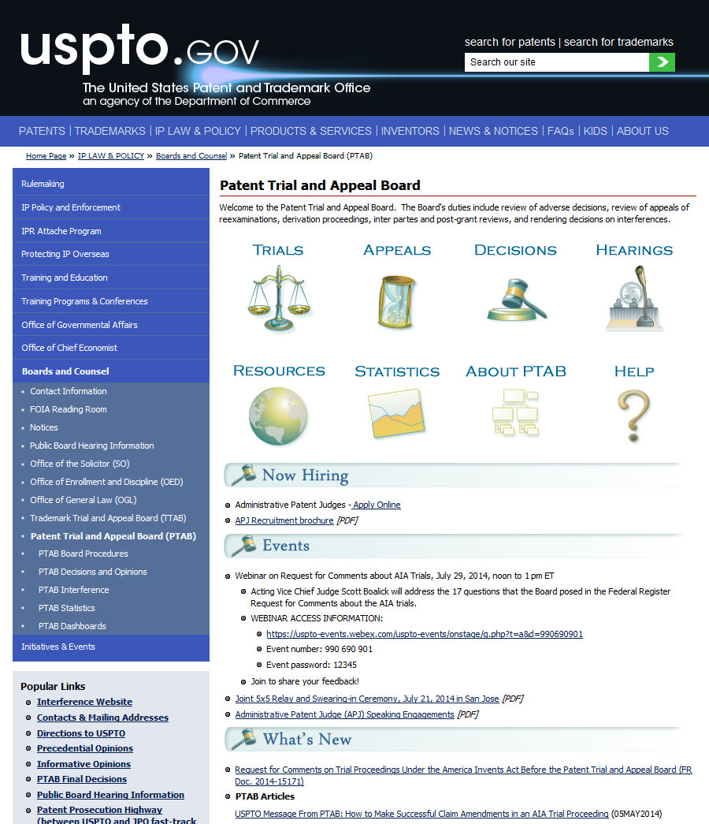
PTAB http://www.uspto.gov/ip/boards/bpai/index.jsp

Slide 4
Request for Comments
2 parts:
  Response to non-rule specific comments from listening tour; and
  Questions about trial proceedings for public comment

Slide 5
Non-rule Specific Comments
Requiring the parties to engage in settlement discussions
Service of Notice of Appeal from PTAB final trial decision
Fairness of trial continuance if parties settle
Scope of estoppel

Slide 6
Non-rule Specific Comments (cont.)
PTAB issuance of precedential and informative decisions
Availability of oral argument audio files and transcripts
Notice of PTAB trial decisions
Availability of trial statistics

Slide 7
Questions for Comment
17 questions posed for public input on many topics
Question 1: Claim Construction Standard
  Under what circumstances, if any, should the Board decline to construe a claim in an unexpired patent in accordance with its broadest reasonable construction in light of the specification of the patent in which it appears?
Question 2: Motion to Amend
  What modifications, if any, should be made to the Board’s practice regarding motions to amend?
Question 3: Patent Owner Preliminary Response
  Should new testimonial evidence be permitted in a Patent Owner Preliminary Response?

Slide 8
Questions for Comment
Question 4: Obviousness
  Under what circumstances should the Board permit discovery of evidence of non-obviousness held by the petitioner, for example, evidence of commercial success for a product of the petitioner? What limits should be placed on such discovery to ensure that the trial is completed by the statutory deadline?
Question 5: Real Party in Interest
  Should a patent owner be able to raise a challenge regarding a real party in interest at any time during a trial?
Question 6: Additional Discovery
  Are the factors enumerated in the Board’s decision in Garmin v. Cuozzo, IPR2012-00001, appropriate to consider in deciding whether to grant a request for additional discovery? What additional factors, if any, should be considered?

Slide 9
Questions for Comment
Questions 7 to 13: Multiple proceedings
  How should multiple proceedings before the USPTO involving the same patent be coordinated? Multiple proceedings before the USPTO include, for example: (i) two or more separate AIA trials; (ii) an AIA trial and a reexamination proceeding; or (iii) an AIA trial and a reissue proceeding?
  What factors should be considered in deciding whether to stay, transfer, consolidate, or terminate an additional proceeding involving the same patent after a petition for AIA trial has been filed?
  Under what circumstances, if any, should a copending reexamination proceeding or reissue proceeding be stayed in favor of an AIA trial? If a stay is entered, under what circumstances should the stay be lifted?
  Under what circumstances, if any, should an AIA trial be stayed in favor of a copending reexamination proceeding or reissue proceeding? If a stay is entered, under what circumstances should the stay be lifted?
  Under what circumstances, if any, should a copending reexamination proceeding or reissue proceeding be consolidated with an AIA trial?
  How should consolidated proceedings be handled before the USPTO? Consolidated proceedings include, for example: (i) consolidated AIA trials; (ii) an AIA trial consolidated with a reexamination proceeding; or (iii) an AIA trial consolidated with a reissue proceeding.
  Under what circumstances, if any, should a petition for an AIA trial be rejected because the same or substantially the same prior art or arguments previously were presented to the USPTO in a different petition for an AIA trial, in a reexamination proceeding or in a reissue proceeding?

Slide 10
Questions for Comment
Question 14: Extension of 1 Year Period to Issue Final Determination
  What circumstances should constitute a finding of good cause to extend the 1-year period for the Board to issue a final determination in an AIA trial?
Questions 15 and 16: Oral Hearing
  Under what circumstances, if any, should live testimony be permitted at the oral hearing?
  What changes, if any, should be made to the format of the oral hearing?
Question 17: General
  What other changes can and should be made in AIA trial proceedings? For example, should changes be made to the Board’s approach to instituting petitions, page limits, or request for rehearing practice?

Slide 11
Thank You

