Slide 1

ABA-IPL Considerations on Glossary Pilot Program
Kevin Greenleaf
Schewgman, Lundberg & Woessner, P.A.

Slide 2

What Controls?
Glossary
Specification
Prosecution History
Extrinsic Evidence
Admissions

Slide 3
Glossaries Can Be Ambiguous
Gradient echo:
a pulse sequence that includes just a single RF pulse for refocusing of phase coherence among spin isochromats at different positions along the magnetic field gradient resulting from (1) balanced negative and positive gradient pulses, or (2) balanced gradient pulses of the same sign on opposite sides of an RF pulse.
University of Virginia Patent Foundation, v. General Electric Company,
755 F. Supp. 2d 738 (W.D. VA 2011)

Slide 4
Glossaries Can Be Ambiguous
Repository:
A repository is a trusted system in that it maintains physical, communications and behavioral integrity.
ZTE v. Contentguard, IPR2013-00139, paper 15

Slide 5
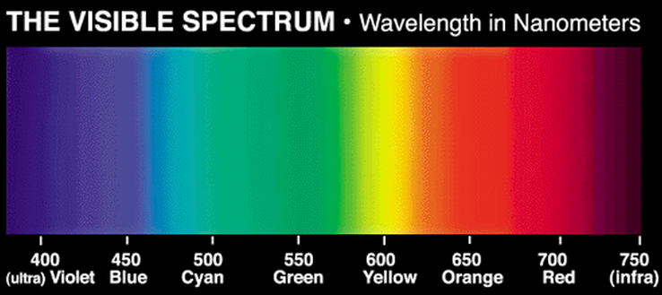
Which Terms Need Defining?

Slide 6
Missing Definitions
New Matter
Transfer out of pilot
Amend glossary – if possible
Examiners require different numbers of definitions

Slide 7
§ 112 Rejections
Examiner Training

Slide 8
Handling Ambiguity
Examiner-Initiated Interviews
Make § 112 rejections
Rule 105
Reject request for pilot

Slide 9
Inexperienced Applicants
Time and care in preparing glossaries
Breadth

Slide 10
Suggestions
Make missing definitions of record
Encourage glossaries in the MPEP
Educate small inventors about pitfalls
Continue to train examiners on § 112
Encourage examiner-initiated interviews
Notes:
First action allowance rate in first action interview pilot program is 32.3%, compared with other non-continuation applications at 10.9%.

