Slide 1
Welcome
First Inventor to File (FITF)
FIRST ANNIVERSARY
Public Forum
Monday, April 1, 2014

Slide 2
Public Forum Agenda
Time | Topic
1:oo PM to 1:15 PM | Welcome Janet Gongola, Senior Advisor to the Deputy Director
 | Opening Remarks Michelle K. Lee, Deputy Under Secretary and Deputy Director
1:15 PM to 2:15 PM | Will My Application Be Examined Under AIA (FITF) Or Not? Cassandra Spyrou, QAS in TC 2800
2:15 PM to 3:00 PM | FITF -- A Year in Review Tom Hughes, SPE in TC 3700
3:00 PM to 3:15 PM | BREAK
3:15 PM to 4:20 PM | FITF Overview and Tips on Responding to Prior Art Rejections Kathleen Fonda, Senior Legal Advisor Office of Patent Legal Administration
4:20 PM to 4:30 PM | Tour of the AIA (FITF) Website Kathleen Bragdon, QAS in TC 1600
4:30 PM to 5:00 PM | Q&A Panel Discussion (Hughes, Spyrou, Fonda, Bragdon) Christopher Grant, QAS in TC 2400 (Moderator)

Slide 3
Test Your Knowledge!
We will be using Poll Everywhere
to challenge the audience with questions during the
presentations.
Your participation is
voluntary.

Slide 4
Polling Notes
Select questions will be asked of the audience during some of the presentations
Answers will be accepted through Poll Everywhere:
Text message (cell phone) or
Web page (cell phone’s Internet browser or computer)
Real-time display of your answers
Let’s Practice!

Slide 5
Polling Introductory Question
Introductory Question ─ YES OR NO? Have you received an Office action on the merits in an AIA (FITF) application?
If texting from your phone, send a text message to phone number 22333 and use the code that corresponds to your answer as the body of your text message.
Codes will differ question-to-question and will be displayed on the current polling slide as, for example:
76101 for Yes
76102 for No
76103 for I Don’t Know
If using the Internet, go to pollev.com/uspto4 from any browser:
Select the appropriate radio button for your answer and submit

Slide 6


Polling Introductory Question
Introductory Question ─ YES OR NO? Have you received an Office action on the merits in an AIA (FITF) application?
For a text message
From any browser
Pollev.com/uspto4
22333
76101 for Yes
76102 for No
76103 for I Don’t
Know
Select appropriate radio button for your answer
76101

Slide 7
POLLING SLIDE
Please participate in the polling by
Texting the code for your answer to phone number 22333
OR
Voting at
pollev.com/uspto4

Slide 8
Public Forum Agenda
Time | Topic
1:oo PM to 1:15 PM | Welcome Janet Gongola, Senior Advisor to the Deputy Director
 | Opening Remarks Michelle K. Lee, Deputy Under Secretary and Deputy Director
1:15 PM to 2:15 PM | Will My Application Be Examined Under AIA (FITF) Or Not? Cassandra Spyrou, QAS in TC 2800
2:15 PM to 3:00 PM | FITF -- A Year in Review Tom Hughes, SPE in TC 3700
3:00 PM to 3:15 PM | BREAK
3:15 PM to 4:20 PM | FITF Overview and Tips on Responding to Prior Art Rejections Kathleen Fonda, Senior Legal Advisor Office of Patent Legal Administration
4:20 PM to 4:30 PM | Tour of the AIA (FITF) Website Kathleen Bragdon, QAS in TC 1600
4:30 PM to 5:00 PM | Q&A Panel Discussion (Hughes, Spyrou, Fonda, Bragdon) Christopher Grant, QAS in TC 2400 (Moderator)

Slide 9
Will My Application
Be Examined Under
AIA (FITF) or Not?
Cassandra Spyrou
Quality Assurance Specialist
Technology Center 2800

Slide 10
Overview
How to determine if your application is subject to the AIA First Inventor to File (FITF) provisions
Pre-AIA or AIA applications
Transition applications
Required statement under 37 CFR 1.55 or 1.78 for AIA transition applications
Scenarios to exemplify AIA determination in practice

Slide 11
Determining AIA (First Inventor to File) Status
The First Inventor to File (FITF) provisions of the AIA, which became effective on March 16, 2013:
DO NOT apply to applications filed before March 16, 2013
(these applications are always pre-AIA (First to Invent or FTI) applications); and
Apply to certain applications filed on or after March 16, 2013.
Note: The U.S. filing date for 35 U.S.C. 371 national stage entries is the international filing date, not the 371(c) date.

Slide 12
Determining AIA (First Inventor to File) Status (cont.)
An application, filed on or after March 16, 2013, is an AIA (FITF) application if:
the application contains or ever contained a claim to an invention that has an effective filing date that is on or after March 16, 2013 (even if all such claims have now been cancelled);
OR
the application is ever a CON, CIP, or DIV of an earlier application that contained at any time a claim having an effective filing date that is on or after March 16, 2013 (even if the domestic benefit claim is later deleted).

Slide 13
Determining AIA (First Inventor to File) Status (cont.)
The AIA definition of “effective filing date” (EFD) in 35 U.S.C. 100(i), which takes foreign priority into account, is used to determine whether any application, filed on or after March 16, 2013, is an AIA (FITF) or a pre-AIA (First To Invent) application (aka “AIA application” or “pre-AIA application,” respectively).
If an application filed on or after March 16, 2013 is determined to be a pre-AIA application, the pre-AIA definition of EFD, which does not take foreign priority into account, is used for examination.

Slide 14
Determining AIA (First Inventor to File) Status (cont.)
What does “contains or ever contained a claim” with an effective filing date on or after March 16, 2013 mean?
An application is considered to contain or to have ever contained such a claim if there is at least one claim having an effective filing date on or after March 16, 2013, that is:
pending and under consideration, or
withdrawn, or
now cancelled.
Claims presented but not entered do not affect the AIA indicator status of an application.

Slide 15
Determining AIA (First Inventor to File) Status (cont.)
What does “contains or ever contained a claim” with an effective filing date on or after March 16, 2013 mean? (cont.)
An application is considered NOT to contain or to have ever contained such a claim if all claims entered have an effective filing date before March 16, 2013.
Note: A claim with an effective filing date on or after March 16, 2013 that is cancelled on the same day that it is filed is considered to have not ever been presented. This is consistent with previous practice.
A claim that comprises new matter, filed on or after March 16, 2013 in a pre-AIA application, will not change the status from pre-AIA to AIA, regardless of the filing date of the application.

Slide 16

Application Types Used to Determine When AIA (FITF) Applies
“pure” pre-AIA (First to Invent) application
“pure” AIA
(First Inventor
to File)
application
transition
application
Filed before 3/16/2013
Filed on or after 3/16/2013 and
at least one foreign priority or domestic benefit claim to an appl’n filed
before 3/16/2013
Filed on or after 3/16/2013
and
ALL foreign priority or
domestic benefit claims, if any, are to an appl’n filed
on or after 3/16/2013
.

Slide 17
Transition Applications
“Transition Applications” = Nonprovisional applications that are:
filed on or after March 16, 2013; and
claim foreign priority to, or domestic benefit of, an application filed before March 16, 2013.
Transition applications may be either pre-AIA applications or AIA applications depending on the effective filing date of the claims in the application.

Slide 18
Transition Applications Can Be Either Pre-AIA or AIA (FITF)
transition
application
Pre-AIA
transition application
Only ever contains claimed inventions that have an EFD before March 16, 2013
AIA (FITF)
transition application
Contains or ever contained any claim to an invention that has an EFD that is on or after March 16, 2013
and/or
Is ever a CON, DIV, or CIP of an AIA (FITF) application
OR

Slide 19
1.55/1.78 Statements for AIA (FITF) Transition Applications
transition
application
Pre-AIA
transition application
No statement under 37 CFR 1.55/1.78 is filed.
AIA (FITF)
transition application
Statement under 37 CFR 1.55/1.78 is required.
OR

Slide 20
1.55/1.78 Statements for AIA (FITF) Transition Applications
When filing a transition application that contains or ever contained a claim to an invention having an effective filing date on or after March 16, 2013, a statement under 37 CFR 1.55 or 1.78 (“the 1.55/1.78 statement”) is required.
Rule 55 relates to foreign priority claims
Rule 78 relates to domestic benefit claims
A 1.78 statement in a child transition application is not needed if a parent contains a 1.55/1.78 statement.

Slide 21
Forms for Making a 1.55/1.78 Statement
Updated versions of the application data sheet (ADS -- Form PTO/AIA/14) and the transmittal letter for 371 national stage filing (Form PTO-1390) are available for an applicant to make the 1.55/1.78 statement by marking a check box on the forms.

Slide 22
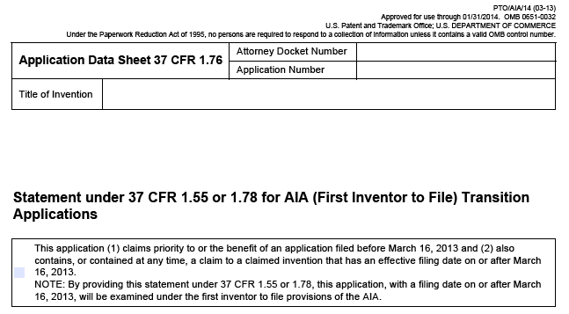
Application Data Sheet with 1.55/1.78 Statement Check Box

Slide 23
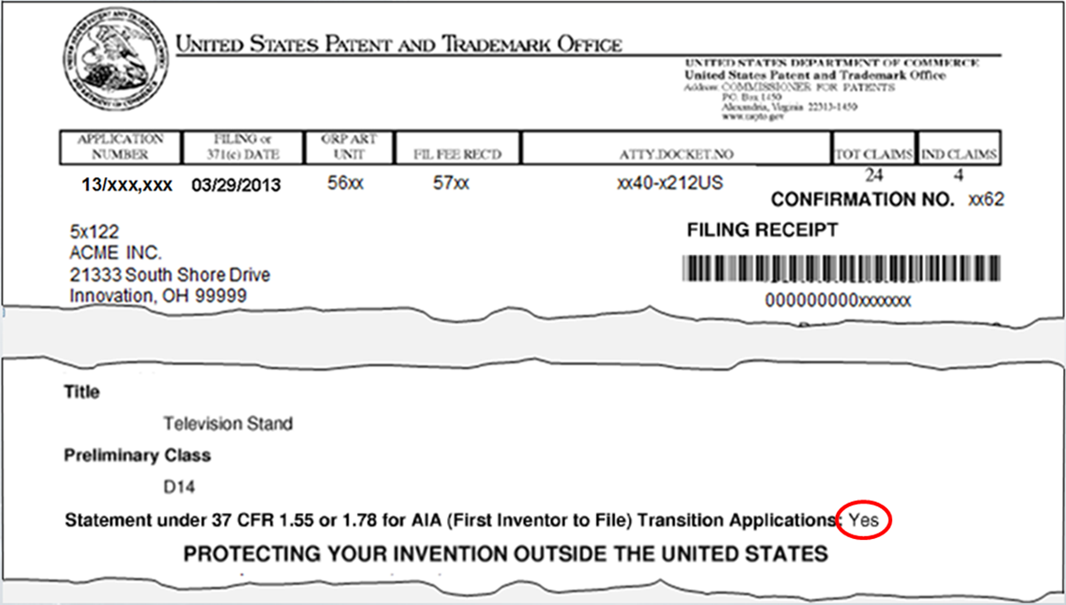
1.55/1.78 Statement Reflected in the Filing Receipt

Slide 24

Making or Rescinding a 1.55/1.78 Statement Using a Separate Paper
If applicant does not select the 1.55/1.78 statement check box on the ADS, applicant may provide the statement in a separate document.
Applicant may also rescind an erroneous 1.55/1.78 statement in a separate document.
To index the above separate documents correctly when filing online, applicant must select the document description “Make/Rescind AIA (First Inventor to File) 1.55/1.78 Stmnt.”

Slide 25
AIA (FITF) Application Types
“pure” pre-AIA (First to Invent) application
“pure” AIA
(First Inventor
to File)
application
transition
application
1.55/1.78 statement
Not Relevant
1.55/1.78 statement
NEEDED IF
the transition application contains or ever contained a claim to an invention having an
EFD on or after 3/16/2013*
1.55/1.78 statement
Not Relevant
.
*A 1.78 statement in a child transition application is not needed if a parent contains a 1.55/1.78 statement.

Slide 26
1.55/1.78 Statement

Slide 27
1.55/1.78 Statement
(1) claims priority to or the benefit of an application filed before March 16, 2013
This application (1) claims priority to or the benefit of an application filed before March 16, 20 and (2) also contains, or contained at any time, a claim to a claimed invention that has an effective filing date on or after March 16, 2013.
NOTE: By providing this statement under 37 CFR 1.55 or 1.78, this application, with a filing date on or after March 16, 2013, will be examined under the first inventor to file provisions of the AIA.

Slide 28
1.55/1.78 Statement
This application (1) claims priority to or the benefit of an application filed before March 16, 2013 and (2) also contains, or contained at any time, a claim to a claimed invention that has an effective filing date on or after March 16, 2013.
NOTE: By providing this statement under 37 CFR 1.55 or 1.78, this application, with a filing date on or after March 16, 2013, will be examined under the first inventor to file provisions of the AIA.
and (2) also
contains, or contained at any time, a claim to a claimed invention that has an effective filing date on or after March 16, 2013.

Slide 29
1.55/1.78 Statement
This application (1) claims priority to or the benefit of an application filed before March 16, 2013 and (2) also contains, or contained at any time, a claim to a claimed invention that has an effective filing date on or after March 16, 2013.
NOTE: By providing this statement under 37 CFR 1.55 or 1.78, this application, with a filing date on or after March 16, 3013, will be examined under the first inventor to file provisions of the AIA.
and (2) also
NOTE: By providing this statement under 37 CFR 1.55 or 1.78, this application, with a filing date on or after March 16, 2013, will be examined under the first inventor to file provisions of the AIA.

Slide 30
AIA First Inventor To File (FITF)
Indicator
Sample Scenarios

Slide 31
Test Your Knowledge!
Consider the following AIA (FITF) Indicator Scenarios ─ we will be polling
for your answers.

Slide 32
Polling Scenario A.1
Continuation
January 15, 2013
March 20, 2013
US Nonprovisional Application 1 is filed
Discloses subject matter A
US Nonprovisional Application 2 is filed All claims limited to subject matter A
March 16, 2013
AIA (FITF) EFFECTIVE
Question A.1 ─ YES OR NO? Should the Applicant make a 1.78 statement in Application 2 resulting in the application being designated as AIA (FITF)?

Slide 33
POLLING SLIDE
Please participate in the polling by
Texting the code for your answer to phone number 22333
OR
Voting at
pollev.com/uspto4

Slide 34
Polling Scenario A.1
Continuation
January 15, 2013
March 20, 2013
US Nonprovisional Application 1 is filed
Discloses subject matter A
US Nonprovisional Application 2 is filed All claims limited to subject matter A
March 16, 2013
AIA (FITF) EFFECTIVE
Question A.1 ─ Should the Applicant make a 1.78 statement in Application 2?
Answer A.1 ─ NO. Although Application 2 is filed after the AIA (FITF) effective date as transition application, there is no claimed invention with an effective filing date on or after 3/16/13.

Slide 35

Scenario A.2
Continuation
January 15, 2013
March 20, 2013
US Nonprovisional Application 1 is filed
US Nonprovisional Application 2 filed 1.78 statement: Yes
March 16, 2013
AIA (FITF) EFFECTIVE
Question A.2 ─ YES OR NO? If the 1.78 statement was provided by the applicant, will the Office designate Application 2 as Pre-AIA?

Slide 36
Scenario A.2
Continuation
January 15, 2013
March 20, 2013
US Nonprovisional Application 1 is filed
US Nonprovisional Application 2 filed 1.78 statement: Yes
March 16, 2013
AIA (FITF) EFFECTIVE
Question A.2 ─ Will the Office designate this application as pre-AIA?
Answer A.2 ─ NO. The Office will designate Application 2 as AIA (FITF). However, a conflict exists between the domestic benefit relationship and the 1.78 statement.

Slide 37
Scenario A.2
Continuation
January 15, 2013
March 20, 2013
US Nonprovisional Application 1 is filed
US Nonprovisional Application 2 filed 1.78 statement: Yes
March 16, 2013
AIA (FITF) EFFECTIVE
CON/DIV Conflict – if identified, the Office will resolve by notifying applicant and designating the application as pre-AIA despite Applicant’s 1.78 statement

Slide 38
Polling Scenario B.1
Continuation-in-Part
January 15, 2013
March 20, 2013
US Nonprovisional Application 1 is filed
Discloses only subject matter A
US Nonprovisional Application 2 is filed Discloses subject matter A and B; some claims include subject matter B
March 16, 2013
AIA (FITF) EFFECTIVE
Question B.1 ─ YES OR NO? Should the Applicant make a 1.78 statement in Application 2 resulting in the application being designated as AIA (FITF)?

Slide 39
POLLING SLIDE
Please participate in the polling by
Texting the code for your answer to phone number 22333
OR
Voting at
pollev.com/uspto4

Slide 40
Polling Scenario B.1
Continuation-in-Part
January 15, 2013
March 20, 2013
US Nonprovisional Application 1 is filed
Discloses only subject matter A
US Nonprovisional Application 2 is filed Discloses subject matter A and B; some claims include subject matter B
March 16, 2013
AIA (FITF) EFFECTIVE
Question B.1 ─ Should the Applicant make a 1.78 statement in Application 2 resulting in the application being designated as AIA (FITF)?
Answer B.1 ─ YES. It is a transition application and there is at least one claimed invention having an effective filing date on or after 3/16/13.

Slide 41
Scenario B.2
Continuation-in-Part
January 15, 2013
March 20, 2013
US Nonprovisional Appl’n 1 filed
Discloses only subject matter A
US Nonprov. Appl’n 2 filed Discloses subject matter A and B; Claims have only ever been drawn to subject matter A
March 16, 2013
AIA (FITF) EFFECTIVE
Question B.2 ─ YES OR NO? Should the Applicant make a 1.78 statement in Application 2 resulting in the application being designated as AIA (FITF)?

Slide 42
Scenario B.2
Continuation-in-Part
January 15, 2013
March 20, 2013
US Nonprovisional Appl’n 1 filed
Discloses only subject matter A
US Nonprov. Appl’n 2 filed Discloses subject matter A and B; Claims have only ever been drawn to subject matter A
March 16, 2013
AIA (FITF) EFFECTIVE
Question B.2 ─ Should the Applicant make a 1.78 statement in Application 2 resulting in the application being designated as AIA (FITF)?
Answer B.2 ─ NO. Although it is an Transition Application, there is no claimed invention with an effective filing date on or after 3/16/13.

Slide 43
Scenario B.3
Continuation-in-Part
January 15, 2013
March 20, 2013
US Nonprovisional Appl’n 1 filed
Discloses only subject matter A
US Nonprov. Appl’n 2 filed Discloses subject matter A and B; Claims have only ever been drawn to subject matter A
Amdt filed in US Nonprov. Appl’n 2
Claims drawn to subject matter A and B
March 16, 2013
AIA (FITF) EFFECTIVE
Question B.3 ─ YES OR NO? When the amendment is filed, should the Applicant make a 1.78 statement in Application 2 resulting in Application 2 being designated as AIA (FITF)?

Slide 44
Scenario B.3
Continuation-in-Part
January 15, 2013
March 20, 2013
US Nonprovisional Appl’n 1 filed
Discloses only subject matter A
US Nonprov. Appl’n 2 filed Discloses subject matter A and B; Claims have only ever been drawn to subject matter A
Amdt filed in US Nonprov. Appl’n 2
Claims drawn to subject matter A and B
March 16, 2013
AIA (FITF) EFFECTIVE
Question B.3 ─ When the amendment is filed, should the Applicant make a 1.78 statement in Application 2 resulting in the application being designated as AIA (FITF)?
Answer B.3 ─ YES. The statement should be filed with the amendment either in a separate paper or by corrected ADS.

Slide 45
Scenario C.1
Foreign Priority Claim
January 15, 2013
March 20, 2013
Japanese Application is filed
Discloses subject matter A
US Nonprovisional Application is filed All claims limited to subject matter A
March 16, 2013
AIA (FITF) EFFECTIVE
Question C.1 ─ YES OR NO? Should the Applicant make a 1.55 statement in the Nonprovisional Application resulting in the application being designated as AIA (FITF)?

Slide 46
Scenario C.1
Foreign Priority Claim
January 15, 2013
March 20, 2013
Japanese Application is filed
Discloses subject matter A
US Nonprovisional Application is filed All claims limited to subject matter A
March 16, 2013
AIA (FITF) EFFECTIVE
Question C.1 ─ Should the Applicant make a 1.55 statement in the Nonprovisional Application resulting in the application being designated as AIA (FITF)?
Answer C.1 ─ NO. Although it is a transition application, there is no claimed invention with an effective filing date on or after 3/16/13.

Slide 47
Scenario C.2
Foreign Priority Claim
January 15, 2013
March 20, 2013
Japanese Application is filed
Discloses only subject matter A
US Nonprovisional Application is filed Discloses subject matter A and B; some claims include subject matter B
March 16, 2013
AIA (FITF) EFFECTIVE
Question C.2 ─ YES OR NO? Should the Applicant make a 1.55 statement in the Nonprovisional Application resulting in the application being designated AIA?

Slide 48
Scenario C.2
Foreign Priority Claim
January 15, 2013
March 20, 2013
Japanese Application is filed
Discloses only subject matter A
US Nonprovisional Application is filed Discloses subject matter A and B; some claims include subject matter B
March 16, 2013
AIA (FITF) EFFECTIVE
Question C.2 ─ Should the Applicant make a 1.55 statement in the Nonprovisional Application resulting in the application being designated as AIA (FITF)?
Answer C.2 ─ YES. It is a transitional application and there is at least one claimed invention having an effective filing date on or after 3/16/13.

Slide 49
Scenario D.1
Domestic Benefit Claims
January 15, 2013
March 20, 2013
January 10, 2014
US Provisional 1
is filed
Discloses subject matter A
US Provisional 2
is filed
Discloses subject matter A and B
US Nonprovisional Application is filed Claims include subject matter B
March 16, 2013
AIA (FITF) EFFECTIVE
Question D.1 ─ YES OR NO? Should the Applicant make a 1.78 statement in the Nonprovisional Application resulting in the application being designated as AIA (FITF)?

Slide 50
Scenario D.1
Domestic Benefit Claims
January 15, 2013
March 20, 2013
January 10, 2014
US Provisional 1
is filed
Discloses subject matter A
US Provisional 2
is filed
Discloses subject matter A and B
US Nonprovisional Application is filed Claims include subject matter B
March 16, 2013
AIA (FITF) EFFECTIVE
Question D.1 ─ Should the Applicant make a 1.78 statement in the Nonprovisional Application resulting in the application being designated as AIA (FITF)?
Answer D.1 ─ YES. It is a transition application with at least one claimed invention having an effective filing date on or after 3/16/13.

Slide 51
Polling Scenario E.1
Continuation
January 15, 2013
March 20, 2013
PCT Application is filed
Discloses subject matter A
US Nonprovisional Application 2 is filed (Bypass) All claims limited to subject matter A
March 16, 2013
AIA (FITF) EFFECTIVE
Question E.1 ─ YES OR NO? Should the Applicant make a 1.78 statement in Application 2 resulting in the application being designated as AIA (FITF)?

Slide 52
POLLING SLIDE
Please participate in the polling by
Texting the code for your answer to phone number 22333
OR
Voting at
pollev.com/uspto4

Slide 53
Polling Scenario E.1
Continuation
January 15, 2013
March 20, 2013
PCT Application is filed
Discloses subject
matter A
US Nonprovisional Application 2 is filed (Bypass) All claims limited to subject matter A
March 16, 2013
AIA (FITF) EFFECTIVE
Question E.1 ─ Should the Applicant make a 1.78 statement in Application 2 resulting in the application being designated as AIA (FITF)?
Answer E.1 ─ NO. Although Application 2 is a transition application, there is no claimed invention with an effective filing date on or after 3/16/13.

Slide 54
Scenario E.2
Foreign Priority
CIP
September 20, 2012
September 20, 2013
March 20, 2015
Japanese Appl’n filed
Discloses subject matter A
PCT Appl’n filed
Designated US
Discloses subject
matter A
US Nonprovisional
Appl’n filed Discloses subject matter A and B; All claims limited to subject matter A
March 16, 2013
AIA (FITF) EFFECTIVE
Question E.2 ─ YES OR NO? Should the Applicant make a 1.55 statement in the Nonprovisional Application resulting in the application being designated as AIA (FITF)?

Slide 55
Scenario E.2
Foreign Priority
CIP
September 20, 2012
September 20, 2013
March 20, 2015
Japanese Appl’n filed
Discloses subject matter A
PCT Appl’n filed
Designated US
Discloses subject
matter A
US Nonprovisional
Appl’n filed Discloses subject matter A and B; All claims limited to subject matter A
March 16, 2013
AIA (FITF) EFFECTIVE
Question E.2 ─ Should the Applicant make a 1.55 statement in the Nonprovisional Application resulting in the application being designated as AIA (FITF)?
Answer E.2 ─ NO. Although the Nonprovisional Appl’n is a transition application, there is no claimed invention with an effective filing date on or after 3/16/13.

Slide 56
Polling Bonus Scenario
National Stage
September 20, 2011
March 20, 2013
PCT filed
Designated US
Discloses subject matter A
Enter US National Stage by completion of 371(c) requirements
All claims limited to subject matter A
March 16, 2013
AIA (FITF) EFFECTIVE
Bonus Question ─ YES OR NO? Should the Applicant make a 1.55/1.78 statement resulting in the national stage application being designated as AIA (FITF)?

Slide 57
POLLING SLIDE
Please participate in the polling by
Texting the code for your answer to phone number 22333
OR
Voting at
pollev.com/uspto4

Slide 58
Polling Bonus Scenario
National Stage
September 20, 2011
March 20, 2013
PCT filed
Designated US
Discloses subject matter A
Enter US National Stage by completion of 371(c) requirements
All claims limited to subject matter A
March 16, 2013
AIA (FITF) EFFECTIVE
Bonus Question ─ Should the Applicant make a 1.55/1.78 statement resulting in the national stage application being designated as AIA (FITF)?
Bonus Answer: NO. The 371 National Stage Application is not a transition application since its filing date is the filing date of the PCT.

Slide 59
“Take Homes”
Think carefully about the 1.55/1.78 statement in a transition application
Effective filing dates are determined on a claim-by-claim basis
It only takes one claim with an effective filing date on or after March 16, 2013 to make the application an AIA (FITF) application
Continuation-in-part transition applications filed on or after March 16, 2013 are not automatically AIA (FITF).
Transition applications that claim foreign priority to/benefit of an application filed before March 16, 2013 are not always Pre-AIA (First to Invent).
Transition CON or DIV applications that include the 1.78 statement appear to be in conflict. A proper transition CON or DIV application would add no new subject matter as compared with the parent, so the effective filing date of all the claims would be prior to March 16, 2013.

Slide 60
FITF ─ A Year In Review
Tom Hughes
Supervisory Patent Examiner
Technology Center 3700

Slide 61
Overview
Review of Examiner Training
FITF Statistics
Lessons Learned
Application Data Sheets
Filing Receipts
Statements under 37 CFR 1.55/1.78

Slide 62
Review of Examiner Training
FITF Overview Training
(March 2013)
Introductory FITF Video
Live Overview Training
Follow-up Video

Slide 63
Review of Examiner Training
FITF Comprehensive Training (Summer 2013)
FITF Definitions Video
AIA Rules/Regulations (non-FITF)
Live Comprehensive Training

Slide 64
Review of Examiner Training
FITF Hands-On-Workshop (HOW)
1st Session August 2013 (ongoing)
Small, Interactive Group Training
Live and Webcast sessions offered
Brief FITF Overview
Mock Application
Office Action Preparation

Slide 65
Review of Examiner Training
AIA (FITF) Indicator Training (January 2014)
Determining AIA (FITF) Status
Review of AIA (FITF) Indicator
Situations Where AIA (FITF) Indicator May Need to be Updated

Slide 66
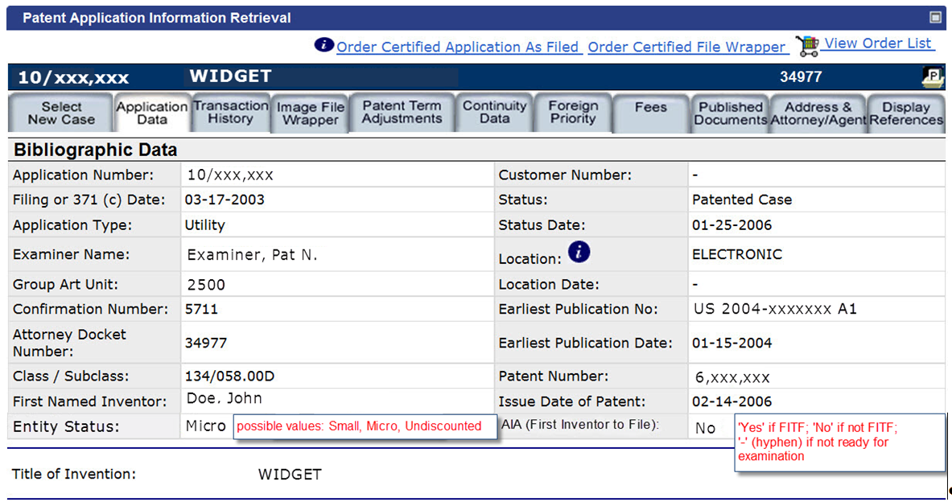
AIA (FITF) Indicator in PAIR

Slide 67
AIA and AIA (FITF)
AIA (FITF) effective date of March 16, 2013
First-Inventor-to-File statutory framework
Certain other AIA provisions and their corresponding regulations had an effective date of September 16, 2012
New rules for oath/declaration
Corrected ADS rules

Slide 68
First Inventor To File (FITF) Statistics
Pending Applications (as of January 2014)
Pre-AIA approximately 86%
AIA (FITF) approximately 14%

Slide 69
First Inventor To File (FITF) Statistics
Applications filed on or after March 16, 2013
Pre-AIA approximately 72%
AIA (FITF) approximately 28%

Slide 70
First Inventor To File (FITF) Statistics
AIA (FITF) Applications*
6462 have received at least a first action
3426 Design (53%)
1460 Track One (22.6%)
553 Other Petition to Make Special (8.6%)
1023 Utility (not fast-tracked) (15.8%)
3427 have been allowed/patented
2794 Design
633 Utility
*as of February 25, 2014

Slide 71
Lesson Learned
Application Data Sheets
Filing Receipts
37 CFR 1.55/1.78 Statements

Slide 72
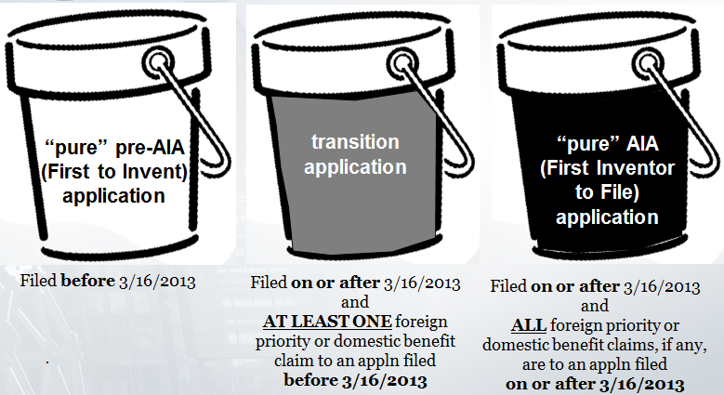
Application Data Sheets, Filing Receipts and 1.55/1.78 Statements
AIA (FITF)-No AIA (FITF)-No or AIA (FITF)-Yes
AIA (FITF)-Yes

Slide 73
Lessons Learned
Take Home #1
Make sure your Application Data Sheets are accurate and complete

Slide 74
Tips for Application Data Sheets
Prior to filing an ADS, double check domestic benefit and/or foreign priority claim information (this is required in an ADS for applications filed on or after September 16, 2012)
Typos in serial numbers
Incorrect filing dates
Wrong relationship type (e.g. CON vs. CIP, etc.)

Slide 75
Tips for Application Data Sheets (cont.)
Be sure to indicate the correct relationship and order of the domestic benefit applications listed on the ADS.
If the order is incorrect, then the Office of Patent Application Processing (OPAP) may not accurately capture the entire benefit claim.
An example of an incorrect relationship is mis-identifying a 371 national stage entry as a CON of an international application.
Another example is non-specific relationship identifiers (e.g. “Continuing” is non-specific; should be Continuation, Divisional or CIP).

Slide 76
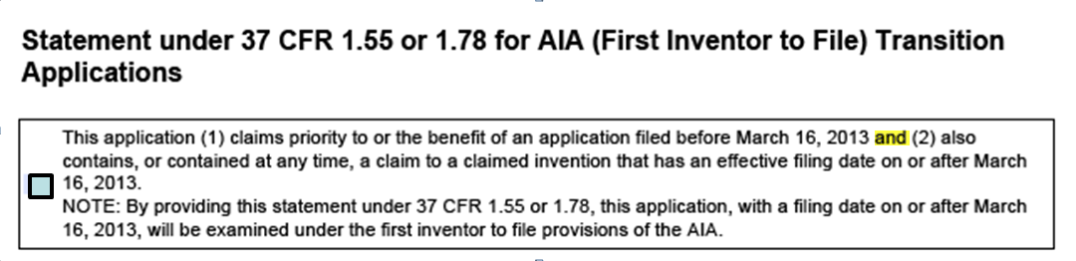
Tips for Application Data Sheets (cont.)
Prior to filing an ADS, review the check box next to the 1.55/1.78 statement
Below is the 1.55/1.78 statement as it appears in the ADS form PTO/AIA/14.

Slide 77
Tips for Application Data Sheets (cont.)
Do NOT check the 1.55/1.78 statement in transition applications that are proper CONs or DIVs of a parent application filed prior to March 16, 2013.
Since March 16, 2013, we have mailed CON/DIV conflict letters and changed the AIA indicator in over 2,000 applications.

Slide 78
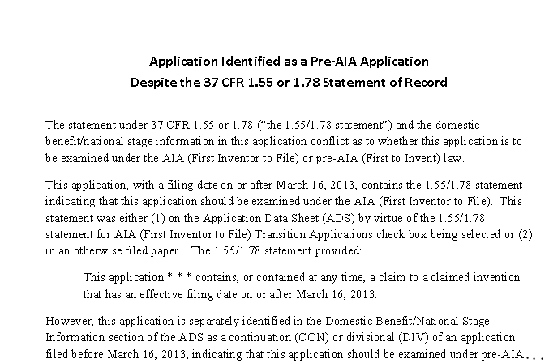
Tips for Application Data Sheets (cont.)
CON/DIV conflict letter

Slide 79
Tips for Application Data Sheets (cont.)
A corrected ADS should be accompanied by a properly identified/indexed paper requesting action, such as,
a request for a corrected filing receipt or
a request to correct inventorship (Rule 48 petition)
Information regarding proper indexing of papers can be found at the following three web sites:
http://www.uspto.gov/ebc/portal/efs/rules_doc_codes.htm
http://www.uspto.gov/patents/process/file/efs/guidance/EFS-WebQuickStartGuide.pdf
http://www.uspto.gov/ebc/portal/efs/cbt/efs-web-training.ppt

Slide 80
Tips for Application Data Sheets (cont.)
A corrected ADS (for applications filed on or after September 16, 2012) must be marked up as set forth in 37 CFR 1.76(c).
A corrected ADS showing changes relative to the information of record is required regardless of whether an ADS has been previously filed or not.
The corrected ADS will not be processed unless markings showing the changes are provided.

Slide 81
Tips for Application Data Sheets (cont.)
Foreign priority and domestic benefit claims in applications filed on or after September 16, 2012 MUST appear in an ADS. See 37 CFR 1.55 for foreign priority claims and 37 CFR 1.78 for domestic benefit claims.
Priority/benefit claims made in the first line of the specification or in the oath/declaration are not effective and will NOT be reflected in the filing receipt.
Make sure the ADS is properly signed.

Slide 82
Lessons Learned
Take Home #2
Check your filing receipts!

Slide 83
Tips for Filing Receipts
Make sure the information in the filing receipt you receive is correct. In particular, check your filing receipt to make sure that:
all domestic benefit and/or foreign priority claims have been accurately captured and
the presence or absence of a 1.55/1.78 statement has been accurately captured.

Slide 84
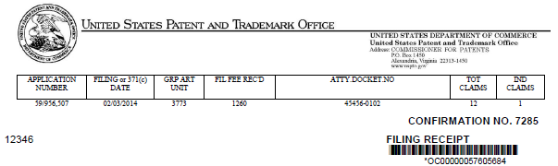
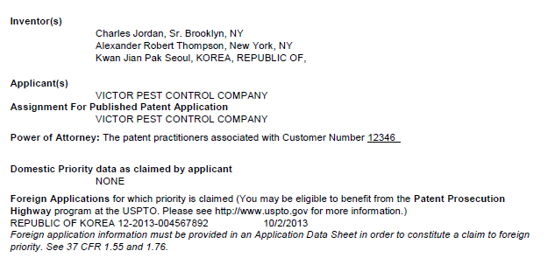
Tips for Filing Receipts (cont.)
Filing receipt
Domestic Benefit Data
Foreign Priority Data

Slide 85
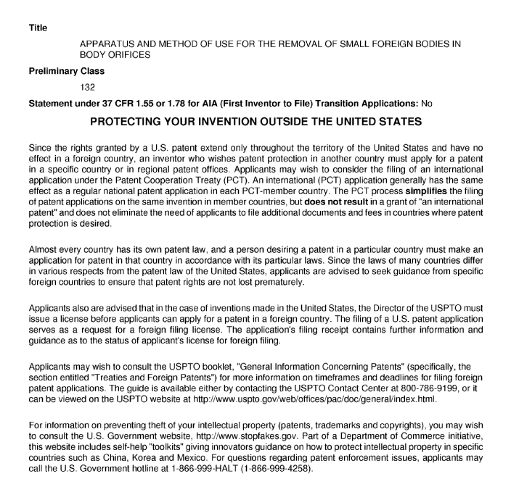
Tips for Filing Receipts (cont.)
1.55/1.78 statement provided?
Trapping Device
Filing receipt, page 2
43

Slide 86
Tips for Filing Receipts (cont.)
If any information you provided on the ADS was not accurately captured by the USPTO, file a request for a corrected filing receipt.
If review of the filing receipt and the ADS identifies applicant errors, file both:
a request to correct the filing receipt and
a corrected ADS

Slide 87
Lessons Learned
Take Home #3
1.55/1.78 statements are not as simple as they appear

Slide 88
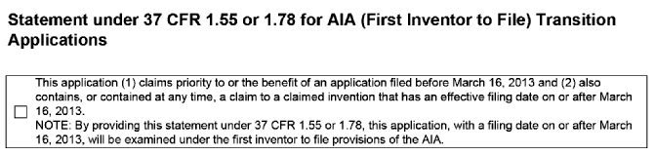
Tips for 1.55/1.78 Statements

Slide 89
Tips for 1.55/1.78 Statements (cont.)
An applicant in a transition application making a 1.55/1.78 statement is asserting that a claim to an invention having an effective filing date on or after March 16, 2013 is present or ever has been present in the application.

Slide 90
Tips for 1.55/1.78 Statements (cont.)
Applicants can make a 1.55/1.78 statement by checking the box on the ADS or in a separate paper.
When 1.55/1.78 statements are made in a separate paper, they should be clear and concise statements

Slide 91
Tips for 1.55/1.78 Statements (cont.)
If an applicant discovers that a 1.55/1.78 statement was made in error, the statement can be rescinded.
When making or rescinding a 1.55/1.78 statement in a separate paper, the paper must be clearly identified as either:
“Statement under 37 CFR 1.55 or 1.78;” or
“Rescission of a Statement under 37 CFR 1.55 or 1.78”
When filing the 1.55/1.78 statement online in a separate paper, applicant must select the document description “Make/Rescind AIA (First Inventor to File) 1.55/1.78 Stmnt”

Slide 92
Summary of Lessons Learned
Make sure your Application Data Sheets are complete and accurate
Check your filing receipts
1.55/1.78 statements are not as simple as they appear

Slide 93
FITF Overview and
Tips on Responding
to Prior Art Rejections
Kathleen K. Fonda
Senior Legal Advisor
Office of Patent Legal Administration

Slide 94
Potential Prior Art Is Identified in 35 U.S.C. 102(a)(1) and 102(a)(2)
Only two subsections of the AIA identify potential prior art:
102(a)(1) is for public disclosures that have a public availability date before the effective filing date of the claimed invention under examination.
102(a)(2) is for issued or published U.S. patent documents that are by another and that have an effectively filed date that is before the effective filing date of the claimed invention under examination.

Slide 95
Effective Filing Date under the AIA
The availability of a disclosure as prior art under 102(a)(1) or 102(a)(2) depends upon the effective filing date (EFD) of the claimed invention.
Unlike pre-AIA law, the AIA provides that a foreign priority date can be the effective filing date of a claimed invention.
During examination, the foreign priority date is treated as the effective filing date of the claimed invention IF
the foreign application supports the claimed invention under 112(a), AND
the applicant has perfected the right of priority by providing:
a certified copy of the priority application, and
a translation of the priority application (if not in English).

Slide 96
AIA Statutory Framework
Prior Art 35 U.S.C. 102(a) (Basis for Rejection) | Exceptions 35 U.S.C. 102(b) (Not Basis for Rejection)
102(a)(1) Disclosure with Prior Public Availability Date | 102(b)(1) | (A) Grace Period Disclosure by Inventor or Obtained from Inventor
 |  | (B) Grace Period Intervening Disclosure by Third Party
102(a)(2) U.S. Patent, Published U.S. Patent Application, and Published PCT Application with Prior Filing Date | 102(b)(2) | (A) Disclosure Obtained from Inventor
 |  | (B) Intervening Disclosure by Third Party
 |  | (C) Commonly Owned Disclosures

Slide 97
35 U.S.C. 102(a)(1): Public Disclosure with Public Availability Date before the Effective Filing Date of the Claimed Invention
102(a)(1) potential prior art includes public disclosures that have a public availability date before the effective filing date of the claimed invention and are:
patented;
described in a printed publication;
in public use;
on sale; or
otherwise available to the public.
Prior Art
102(a)(1) date
(the public availability date of the disclosure)
effective filing date of claimed invention

Slide 98
102(b)(1)(A) Exception to Potential Prior Art under 35 U.S.C. 102(a)(1)
For the 102(b)(1)(A) exception to apply to a public disclosure under 102(a)(1), the public disclosure must be:
within the grace period and
an "inventor-originated disclosure" (i.e., the subject matter in the public disclosure must be attributable to the inventor, one or more co-inventors, or another who obtained the subject matter directly or indirectly from the inventor or a co-inventor).

Slide 99
102(b)(1)(B) Exception to Potential Prior Art under 35 U.S.C. 102(a)(1)
For the 102(b)(1)(B) exception to apply to a third party's disclosure under 102(a)(1):
the third party's disclosure must have been made during the grace period of the claimed invention,
an inventor-originated disclosure (i.e., shielding disclosure) must have been made prior to the third party's disclosure, and
both the third party's disclosure and the inventor-originated disclosure must have disclosed the same subject matter.

Slide 100
Recognizing a 102(b)(1)(A) or 102(b)(1)(B) Exception to a Potential 102(a)(1) Reference
An exception under 102(b)(1)(A) or 102(b)(1)(B) may apply when:
the authorship/inventorship of the potential reference disclosure only includes one or more joint inventor(s) or the entire inventive entity of the application under examination, or
there is an appropriate affidavit or declaration under 37 CFR 1.130(a) (attribution) or 1.130(b) (prior public disclosure), or
the specification of the application under examination identifies the potential prior art disclosure as having been made by or having originated from one or more members of the inventive entity, in accordance with 37 CFR 1.77(b)(6).

Slide 101
35 U.S.C. 102(a)(2): U.S. Patent Documents with Effectively Filed Date before Effective Filing Date of the Claimed Invention
102(a)(2) potential prior art includes issued or published U.S. patent documents that name another inventor and have an effectively filed date before the effective filing date of the claimed invention:
U.S. Patent;
U.S. Patent Application Publication; or
WIPO published PCT (international) application that designates the United States
Prior Art
102(a)(2) date
(the effectively filed date of U.S. patent document)
effective filing date of claimed invention

Slide 102
102(b)(2)(A) Exception to Potential Prior Art under 35 U.S.C. 102(a)(2)
For the 102(b)(2)(A) exception to apply to a potential prior art U.S. patent document, the U.S. patent document must:
disclose subject matter that was obtained from one or more members of the inventive entity, either directly or indirectly.

Slide 103
102(b)(2)(B) Exception to Potential Prior Art under 35 U.S.C. 102(a)(2)
For the 102(b)(2)(B) exception to apply to a third party's potential prior art U.S. patent document:
the third party's U.S. patent document must have been effectively filed before the effective filing date of the claimed invention,
an inventor-originated disclosure (i.e., shielding disclosure) must have been made prior to the effectively filed date of the third party's U.S. patent document, and
both the third party's U.S patent document and the inventor-originated disclosure must have disclosed the same subject matter.

Slide 104
Recognizing a 102(b)(2)(A) or 102(b)(2)(B) Exception to a Potential 102(a)(2) Reference
An exception under 102(b)(2)(A) or 102(b)(2)(B) may apply when:
the inventive entity of the disclosure only includes one or more joint inventor(s), but not the entire inventive entity, of the application under examination, or
there is an appropriate affidavit or declaration under 37 CFR 1.130(a) (attribution) or 1.130(b) (prior public disclosure), or
the specification of the application under examination identifies the potential prior art disclosure as having been made by or having originated from one or more members of the inventive entity, in accordance with 37 CFR 1.77(b)(6).

Slide 105
102(b)(2)(C) Exception to Potential Prior Art under 35 U.S.C. 102(a)(2)
For the 102(b)(2)(C) exception to apply, the subject matter of the U.S. patent document and the claimed invention in the application under examination must have been:
owned by the same person,
subject to an obligation of assignment to the same person, or
deemed to have been owned by or subject to an obligation of assignment to the same person, in view of a joint research agreement,
not later than the effective filing date of the claimed invention.

Slide 106
Recognizing a 102(b)(2)(C) Exception to a Potential 102(a)(2) Reference
A statement on the record that either common ownership in accordance with 102(b)(2)(C) or a joint research agreement (JRA) in accordance with 102(c) were in place may be made.
A declaration or affidavit is not necessary.
In the case of a JRA, the application must name or be amended to name the parties to the JRA.

Slide 107
First Inventor To File (FITF)
Sample Scenarios

Slide 108
Test Your Knowledge!
Consider the following first-inventor-to-file examination scenarios and choose the best answer.

Slide 109
Scenario 1. Traversing a Rejection under 35 U.S.C. 102(a)(1)
On March 16, 2013, Sullivan files a nonprovisional utility patent application at the USPTO.
Sullivan does not assert any foreign priority or domestic benefit under 35 U.S.C. 119, 120, 121, or 365.
The patent examiner rejects all of the claims as anticipated under 35 U.S.C. 102(a)(1) by a journal article to Duffy, which became available to the public on January 8, 2013.

Slide 110
Scenario 1. Traversing a Rejection under 35 U.S.C. 102(a)(1)
March 16, 2012
Duffy's journal article January 8, 2013
March 16, 2013
Sullivan's EFD
Sullivan's Grace Period
How could Sullivan properly traverse the examiner's 102(a)(1) rejection over Duffy?

Slide 111
Scenario 1. Traversing a Rejection under 35 U.S.C. 102(a)(1)
March 16, 2012
Duffy's journal article January 8, 2013
March 16, 2013
Sullivan's EFD
Sullivan's Grace Period
Q1.1 – TRUE OR FALSE? Sullivan could properly traverse by arguing that the Duffy article is not prior art under 102(a)(1) because it became available to the public during Sullivan's one-year grace period.

Slide 112
Scenario 1. Traversing a Rejection under 35 U.S.C. 102(a)(1)
March 16, 2012
Duffy's journal article January 8, 2013
March 16, 2013
Sullivan's EFD
Sullivan's Grace Period
A1.1 – FALSE. The subject matter of the Duffy article did not originate with Sullivan, so 102(b)(1)(A) does not apply. Likewise, Sullivan (or another who got the information from him) did not disclose the subject matter within the year prior to his filing date and before the Duffy article, so 102(b)(1)(B) also does not apply.

Slide 113
Scenario 1. Traversing a Rejection under 35 U.S.C. 102(a)(1)
December 13, 2011
Sullivan's invention date
March 16, 2012
Duffy's journal article January 8, 2013
March 16, 2013
Sullivan's EFD
Sullivan's Grace Period
Q1.2 – TRUE OR FALSE? Sullivan could properly traverse the rejection by presenting a declaration under 37 CFR 1.131 establishing that Sullivan's invention date was December 13, 2011.

Slide 114
Scenario 1. Traversing a Rejection under 35 U.S.C. 102(a)(1)
December 13, 2011
Sullivan's invention date
March 16, 2012
Duffy's journal article January 8, 2013
March 16, 2013
Sullivan's EFD
Sullivan's Grace Period
A1.2 – FALSE. Because the AIA is a first-inventor-to-file system rather than a first-to-invent system, an applicant cannot overcome a reference by showing an earlier date of invention.

Slide 115
Scenario 1. Traversing a Rejection under 35 U.S.C. 102(a)(1)
March 16, 2013
inventions commonly owned
March 16, 2012
Duffy's journal article January 8, 2013
March 16, 2013
Sullivan's EFD
Sullivan's Grace Period
Q1.3 – TRUE OR FALSE? Sullivan could properly traverse by presenting a statement under 35 U.S.C. 102(b)(2)(C) that the invention described in the Duffy article and the Sullivan application were commonly owned on March 16, 2013.

Slide 116
Scenario 1. Traversing a Rejection under 35 U.S.C. 102(a)(1)
March 16, 2013
inventions commonly owned
March 16, 2012
Duffy's journal article January 8, 2013
March 16, 2013
Sullivan's EFD
Sullivan's Grace Period
A1.3 – FALSE. The rejection was made under 102(a)(1), and the common ownership exception of 102(b)(2)(C) only applies to rejections made under 102(a)(2). Therefore, even though Sullivan can establish common ownership as of his effective filing date, the traversal is unavailing.

Slide 117
Scenario 1. Traversing a Rejection under 35 U.S.C. 102(a)(1)
37 CFR 1.132 declaration
of commercial success
March 16, 2012
Duffy's journal article January 8, 2013
March 16, 2013
Sullivan's EFD
Sullivan's Grace Period
Q1.4 – TRUE OR FALSE? Sullivan could properly traverse by submitting a 37 CFR 1.132 declaration about the commercial success of his invention, including sales figures as well as market share, and establishing a nexus between the claimed invention and the commercial success.

Slide 118
Scenario 1. Traversing a Rejection under 35 U.S.C. 102(a)(1)
37 CFR 1.132 declaration
of commercial success
March 16, 2012
Duffy's journal article January 8, 2013
March 16, 2013
Sullivan's EFD
Sullivan's Grace Period
A1.4 – FALSE. A declaration to establish so-called "secondary considerations" such as commercial success may be used to traverse an obviousness rejection, but not an anticipation rejection. This applies to both AIA and pre-AIA applications.

Slide 119
Scenario 2. Traversing a Rejection under 35 U.S.C. 102(a)(2)
Dolan filed his patent application on December 16, 2013. The application contains one claim directed to widget X.
Dolan exhibited his invention at a trade show on December 30, 2012.
The examiner locates a U.S. patent application publication disclosing widget X to Flanagan. The application was filed on October 16, 2013 and published on April 23, 2015.

Slide 120
Scenario 2. Traversing a Rejection under 35 U.S.C. 102(a)(2)
December 30, 2012
Dolan's trade show exhibition
October 16, 2013
Flanagan's filing
December 16, 2013
Dolan's filing
April 23, 2015
Flanagan's PGPub
Dolan's attorney receives an Office action rejecting the claim under 35 U.S.C. 102(a)(2) over Flanagan's patent application publication. How could she properly respond to the Office action?

Slide 121
Polling Scenario 2. Traversing a Rejection under 35 U.S.C. 102(a)(2)
37 CFR 1.130(a) declaration of attribution
December 30, 2012
Dolan's trade show exhibition
October 16, 2013
Flanagan's filing
December 16, 2013
Dolan's filing
April 23, 2015
Flanagan's PGPub
Q2.1 – TRUE OR FALSE? Dolan's attorney can submit a declaration under 37 CFR 1.130(a) to establish that the subject matter disclosed in Flanagan's application was invented by Dolan, and that Flanagan obtained it directly or indirectly from him.

Slide 122
POLLING SLIDE
Please participate in the polling by
Texting the code for your answer to phone number 22333
OR
Voting at
pollev.com/uspto4

Slide 123
Polling Scenario 2. Traversing a Rejection under 35 U.S.C. 102(a)(2)
37 CFR 1.130(a) declaration of attribution
December 30, 2012
Dolan's trade show exhibition
October 16, 2013
Flanagan's filing
December 16, 2013
Dolan's filing
April 23, 2015
Flanagan's PGPub
A2.1 – TRUE. Dolan can invoke the 35 U.S.C. 102(b)(2)(A) exception by submitting a declaration under 37 CFR 1.130(a) showing that Flanagan directly or indirectly obtained the subject matter he disclosed from Dolan, who invented it.

Slide 124
Scenario 2. Traversing a Rejection under 35 U.S.C. 102(a)(2)
37 CFR 1.130(b) declaration of prior public disclosure
December 30, 2012
Dolan's trade show exhibition
October 16, 2013
Flanagan's filing
December 16, 2013
Dolan's filing
April 23, 2015
Flanagan's PGPub
Q2.2 – TRUE OR FALSE? Dolan's attorney can properly traverse the rejection by submitting a declaration under 37 CFR 1.130(b) to establish that Dolan had publicly disclosed the widget before the date that Flanagan's application was effectively filed.

Slide 125
Scenario 2. Traversing a Rejection under 35 U.S.C. 102(a)(2)
37 CFR 1.130(b) declaration of prior public disclosure
December 30, 2012
Dolan's trade show exhibition
October 16, 2013
Flanagan's filing
December 16, 2013
Dolan's filing
April 23, 2015
Flanagan's PGPub
A2.2 – TRUE. Dolan can invoke the 35 U.S.C. 102(b)(2)(B) exception by submitting a declaration under 37 CFR 1.130(b) to show that he had publicly disclosed the invention before Flanagan's patent application publication was effectively filed.

Slide 126
Scenario 3. Relying on the Common Ownership Exception under 35 U.S.C. 102(b)(2)(C)
Grady filed a patent application, assigned to ACME Corp., on December 16, 2013. His application contains one claim directed to method Z2.
The examiner found a PCT application publication by O'Hara, published on January 18, 2014, assigned to ACME Corp., which disclosed method Z1. The PCT application designated the United States and was filed on July 20, 2013. It claimed benefit of a provisional application filed on July 20, 2012, which also disclosed method Z1.
Z2 is obvious over Z1. The examiner issues an Office action rejecting Grady's claim under 35 U.S.C. 103 as obvious over O'Hara's published PCT application.

Slide 127
Scenario 3. Relying on the Common Ownership Exception under 35 U.S.C. 102(b)(2)(C)
July 20, 2012
O'Hara's provisional filing discloses Z1
July 20, 2013
O'Hara's PCT filing assigned to ACME discloses Z1
December 16, 2013
Grady's filing assigned to ACME
claims Z2
January 18, 2014
O'Hara's PCT pub
Consider whether Grady's attorney may invoke the common ownership exception to establish that the O'Hara publication is not prior art to Grady's claimed invention.

Slide 128
Polling Scenario 3. Relying on the Common Ownership Exception under 35 U.S.C. 102(b)(2)(C)
July 20, 2012
O'Hara's provisional filing discloses Z1
July 20, 2013
O'Hara's PCT filing assigned to ACME discloses Z1
December 16, 2013
Grady's filing assigned to ACME
claims Z2
January 18, 2014
O'Hara's PCT pub
Q3.1 – TRUE OR FALSE? Grady's attorney may not invoke the common ownership exception because O'Hara's PCT publication was effectively filed on July 20, 2012, which is more than one year before Grady's effective filing date.

Slide 129
POLLING SLIDE
Please participate in the polling by
Texting the code for your answer to phone number 22333
OR
Voting at
pollev.com/uspto4

Slide 130
Polling Scenario 3. Relying on the Common Ownership Exception under 35 U.S.C. 102(b)(2)(C)
July 20, 2012
O'Hara's provisional filing discloses Z1
July 20, 2013
O'Hara's PCT filing assigned to ACME discloses Z1
December 16, 2013
Grady's filing assigned to ACME
claims Z2
January 18, 2014
O'Hara's PCT pub
A3.1 – FALSE. Under 102(a)(2), O'Hara's PCT publication may be prior art as of July 20, 2012, the date it was effectively filed. However, the 102(b)(2)(A), 102(b)(2)(B), and 102(b)(2)(C) exceptions, which apply to 102(a)(2) disclosures, are not limited to disclosures during Grady's one-year grace period. Thus, Grady may invoke the common ownership exception of 102(b)(2)(C).

Slide 131
Scenario 3. Relying on the Common Ownership Exception under 35 U.S.C. 102(b)(2)(C)
July 20, 2012
O'Hara's provisional filing discloses Z1
July 20, 2013
O'Hara's PCT filing assigned to ACME discloses Z1
December 16, 2013
Grady's filing assigned to ACME
claims Z2
January 18, 2014
O'Hara's PCT pub
Q3.2 – TRUE OR FALSE? Although Grady's attorney may invoke the common ownership exception to overcome the examiner's obviousness rejection, he could not have done so if the examiner had made an anticipation rejection.

Slide 132
Scenario 3. Relying on the Common Ownership Exception under 35 U.S.C. 102(b)(2)(C)
July 20, 2012
O'Hara's provisional filing discloses Z1
July 20, 2013
O'Hara's PCT filing assigned to ACME discloses Z1
December 16, 2013
Grady's filing assigned to ACME
claims Z2
January 18, 2014
O'Hara's PCT pub
Q3.2 – FALSE. Unlike the pre-AIA 103(c) common ownership exception which applies only to obviousness rejections, the 102(b)(2)(C) exception under the AIA may be invoked to overcome both obviousness and anticipation rejections.

Slide 133
Scenario 3. Relying on the Common Ownership Exception under 35 U.S.C. 102(b)(2)(C)
statement that on December 16, 2013, Z1 and Z2 were commonly owned
July 20, 2012
O'Hara's provisional filing discloses Z1
July 20, 2013
O'Hara's PCT filing assigned to ACME discloses Z1
December 16, 2013
Grady's filing assigned to ACME
claims Z2
January 18, 2014
O'Hara's PCT pub
Q3.3 – TRUE OR FALSE? If Grady's attorney provides a statement that Grady's claimed method Z2 and O'Hara's disclosed method Z1 were commonly owned as of December 16, 2013, he can expect the examiner to withdraw the rejection.

Slide 134
Scenario 3. Relying on the Common Ownership Exception under 35 U.S.C. 102(b)(2)(C)
statement that on December 16, 2013, Z1 and Z2 were commonly owned
July 20, 2012
O'Hara's provisional filing discloses Z1
July 20, 2013
O'Hara's PCT filing assigned to ACME discloses Z1
December 16, 2013
Grady's filing assigned to ACME
claims Z2
January 18, 2014
O'Hara's PCT pub
A3.3 – TRUE. A statement that Grady's claimed method Z2 and O'Hara's disclosed method Z1 were commonly owned as of Grady's effective filing date is sufficient. A declaration is not needed.

Slide 135
Scenario 3A. Relying on the Common Ownership Exception under 35 U.S.C. 102(b)(2)(C)
Grady filed a patent application, assigned to ACME Corp., on December 16, 2013. His application contains one claim directed to method Z2.
The examiner found a PCT application publication by O'Hara, published on January 18, 2014, assigned to ACME APEX Corp., which disclosed method Z1. The PCT application designated the United States and was filed on July 20, 2013. It claimed benefit of a provisional application filed on July 20, 2012, which also disclosed method Z1.
Z2 is obvious over Z1. The examiner issues an Office action rejecting Grady's claim under 35 U.S.C. 103 as obvious over O'Hara's published PCT application.

Slide 136
Scenario 3A. Relying on the Common Ownership Exception under 35 U.S.C. 102(b)(2)(C)
JRA statement and amendment to the specification
July 20, 2012
O'Hara's provisional filing discloses Z1
July 20, 2013
O'Hara's PCT filing assigned to APEX discloses Z1
December 16, 2013
Grady's filing assigned to ACME
claims Z2
January 18, 2014
O'Hara's PCT pub
Q3.4 – TRUE OR FALSE? If Grady's attorney provides a statement that ACME and APEX were parties to a joint research agreement (JRA) in effect on or before December 16, 2013, and that Grady's claimed method Z2 resulted from activities within the scope of the JRA, then he can expect the examiner to withdraw the rejection as long as he amends the specification to disclose the names of the parties to the JRA.

Slide 137
Scenario 3A. Relying on the Common Ownership Exception under 35 U.S.C. 102(b)(2)(C)
JRA statement and amendment
to the specification
July 20, 2012
O'Hara's provisional filing discloses Z1
July 20, 2013
O'Hara's PCT filing assigned to APEX discloses Z1
December 16, 2013
Grady's filing assigned to ACME
claims Z2
January 18, 2014
O'Hara's PCT pub
A3.4 – TRUE. An appropriate JRA statement by Grady's attorney is sufficient to overcome an anticipation or obviousness rejection based on a 102(a)(2) disclosure, provided that the specification names or is amended to name the parties to the JRA. A declaration is not needed.

Slide 138
Scenario 4. Traversing a Rejection under 35 U.S.C. 102(a)(1) or 102(a)(2)
On May 1, 2014, Kelly files a nonprovisional patent application at the USPTO claiming invention X.
Kelly asserts a foreign priority claim under 35 U.S.C. 119(a)-(d) based on his Australian application filed May 1, 2013. He submits a certified copy of the English-language Australian application to the USPTO. The Australian application provides support under 35 U.S.C. 112(a) for invention X.
The examiner rejects Kelly's claims as anticipated under 35 U.S.C. 102(a)(1) and 102(a)(2) by a U.S. patent application publication to O'Brien dated January 8, 2013, based on an application filed on July 8, 2011. O'Brien's application discloses invention X. There are no other rejections of record, and the examiner is not aware of any other relevant art.

Slide 139
Polling Scenario 4. Traversing a Rejection under 35 U.S.C. 102(a)(1) or 102(a)(2)
December 20, 2012
Kelly's public disclosure of invention X
July 8, 2011
O'Brien's US filing; invention X disclosed
January 8, 2013
O'Brien's US PGPub; invention X disclosed
May 1, 2013
Kelly's AU filing; invention X has 112(a) support
May 1, 2014
Kelly's US filing; invention X claimed
Q4.1 – TRUE OR FALSE? If Kelly submits a declaration under 37 CFR 1.130(b) showing that he had publicly disclosed invention X on December 20, 2012, he should expect allowance of his claims if there are no other issues that impact patentability.

Slide 140
POLLING SLIDE
Please participate in the polling by
Texting the code for your answer to phone number 22333
OR
Voting at
pollev.com/uspto4

Slide 141
Polling Scenario 4. Traversing a Rejection under 35 U.S.C. 102(a)(1) or 102(a)(2)
December 20, 2012
Kelly's public disclosure of invention X
July 8, 2011
O'Brien's US filing; invention X disclosed
January 8, 2013
O'Brien's US PGPub; invention X disclosed
May 1, 2013
Kelly's AU filing; invention X has 112(a) support
May 1, 2014
Kelly's US filing; invention X claimed
A4.1 – FALSE. Kelly's declaration establishes that O'Brien's PGPub is not 102(a)(1) art as of its publication date, but O'Brien's PGPub is still 102(a)(2) art as of the date that it was effectively filed.

Slide 142
Scenario 4. Traversing a Rejection under 35 U.S.C. 102(a)(1) or 102(a)(2)
June 25, 2011
Kelly's public disclosure of invention X
July 8, 2011
O'Brien's US filing; invention X disclosed
January 8, 2013
O'Brien's US PGPub; invention X disclosed
May 1, 2013
Kelly's AU filing; invention X has 112(a) support
May 1, 2014
Kelly's US filing; invention X claimed
Q4.2 – TRUE OR FALSE? If Kelly submits a declaration under 37 CFR 1.130(b) showing that he had publicly disclosed invention X on June 25, 2011, he should expect allowance of his claims if there are no other issues that impact patentability.

Slide 143
Scenario 4. Traversing a Rejection under 35 U.S.C. 102(a)(1) or 102(a)(2)
June 25, 2011
Kelly's public disclosure of invention X
July 8, 2011
O'Brien's US filing; invention X disclosed
January 8, 2013
O'Brien's US PGPub; invention X disclosed
May 1, 2013
Kelly's AU filing; invention X has 112(a) support
May 1, 2014
Kelly's US filing; invention X claimed
A4.2 – FALSE. Although Kelly's declaration under 37 CFR 1.130(b) is sufficient to establish that O'Brien's PGPub is not prior art under either 102(a)(1) or 102(a)(2), Kelly's prior public disclosure is itself 102(a)(1) prior art to Kelly's claimed invention.

Slide 144
Scenario 5. Traversing a Rejection under 35 U.S.C. 102(a)(1)
On July 1, 2014, Flynn files a CIP of his earlier nonprovisional patent application filed March 1, 2013.
Claims 1-5 to invention AB were supported in the March 1, 2013 parent application. Claims 6-10 to invention AC were newly added in the July 1, 2014 CIP, and were not supported in the parent application.
The examiner rejects all of Flynn's claims as anticipated by a June 8, 2012 trade show exhibit by Hogan which included inventions AB and AC.

Slide 145
Polling Scenario 5. Traversing a Rejection under 35 U.S.C. 102(a)(1)
May 16, 2012
Flynn's public disclosure of AB and AC
37 CFR 1.77(b)(6) statement in the CIP specification as filed
June 8, 2012
Hogan's exhibit of AB and AC
March 1, 2013
Flynn's parent filing;
AB disclosed but not AC
July 1, 2014
Flynn's CIP filing; claims 1-5 to AB; claims 6-10 to AC
Q5.1 – TRUE OR FALSE? If Flynn responds by pointing out a statement under 37 CFR 1.77(b)(6) in the specification as filed, which asserts that he had publicly disclosed AB and AC on May 16, 2012, he should expect the examiner to withdraw the rejection of claims 1-5 over the Hogan exhibit.

Slide 146
POLLING SLIDE
Please participate in the polling by
Texting the code for your answer to phone number 22333
OR
Voting at
pollev.com/uspto4

Slide 147
Polling Scenario 5. Traversing a Rejection under 35 U.S.C. 102(a)(1)
May 16, 2012
Flynn's public disclosure of AB and AC
37 CFR 1.77(b)(6) statement in the CIP specification as filed
One-year grace period claims 1-5
June 8, 2012
Hogan's exhibit of AB and AC
March 1, 2013
Flynn's parent filing;
AB disclosed but not AC
July 1, 2014
Flynn's CIP filing; claims 1-5 to AB; claims 6-10 to AC
A5.1 – TRUE. All claims in the CIP are examined under FITF, but the effective filing date of claims 1-5 is March 1, 2013. Hogan's exhibit is a 102(a)(1) disclosure within the grace period for claims 1-5. Therefore the rejection can be overcome by relying on a 1.77(b)(6) statement present upon filing to invoke the 102(b)(1)(B) exception.

Slide 148
Scenario 5. Traversing a Rejection under 35 U.S.C. 102(a)(1)
May 16, 2012
Flynn's public disclosure of AB and AC
37 CFR 1.77(b)(6) statement in the CIP specification as filed
June 8, 2012
Hogan's exhibit of AB and AC
March 1, 2013
Flynn's parent filing;
AB disclosed but not AC
July 1, 2014
Flynn's CIP filing; claims 1-5 to AB; claims 6-10 to AC
Q5.2 – TRUE OR FALSE? If Flynn responds to the rejection by pointing out a statement under 37 CFR 1.77(b)(6) in the specification as filed, which asserts that he had publicly disclosed AB and AC on May 16, 2012, he should expect the rejection of claims 6-10 to be withdrawn.

Slide 149
Scenario 5. Traversing a Rejection under 35 U.S.C. 102(a)(1)
May 16, 2012
Flynn's public disclosure of AB and AC
37 CFR 1.77(b)(6) statement in the CIP specification as filed
One-year grace period claims 6-10
June 8, 2012
Hogan's exhibit of AB and AC
March 1, 2013
Flynn's parent filing;
AB disclosed but not AC
July 1, 2014
Flynn's CIP filing; claims 1-5 to AB; claims 6-10 to AC
A5.2 – FALSE. All claims in the CIP are examined under FITF, but the effective filing date of claims 6-10 is July 1, 2014. Hogan's exhibit is a 102(a)(1) disclosure outside the grace period for claims 6-10. Therefore the rejection cannot be overcome by invoking the 102(b)(1)(B) exception via a 1.77(b)(6) statement. Furthermore, Flynn's disclosure is itself prior art to claims 6-10.

Slide 150
Scenario 5. Traversing a Rejection under 35 U.S.C. 102(a)(1)
June 8, 2012
Hogan's exhibit of AB and AC
March 1, 2013
Flynn's parent filing;
AB disclosed but not AC
July 1, 2014
Flynn's CIP filing; claims 1-5 to AB; claims 6-10 to AC
Q5.3 – TRUE OR FALSE? If Flynn responds to the rejection by submitting a declaration under 37 CFR 1.130(a) establishing that inventions AB and AC were his own work, and that Hogan obtained them from him, Flynn should expect the rejection of claims 1-5 to AB over Hogan to be withdrawn.

Slide 151
Scenario 5. Traversing a Rejection under 35 U.S.C. 102(a)(1)
One-year grace period claims 1-5
June 8, 2012
Hogan's exhibit of AB and AC
March 1, 2013
Flynn's parent filing;
AB disclosed but not AC
July 1, 2014
Flynn's CIP filing; claims 1-5 to AB; claims 6-10 to AC
A5.3 – TRUE. All claims in the CIP are examined under FITF, but the effective filing date of claims 1-5 is March 1, 2013. Hogan's exhibit is a 102(a)(1) disclosure within the grace period for claims 1-5. Therefore the rejection can be overcome by using a 130(a) declaration (attribution) to invoke the 102(b)(1)(A) exception.

Slide 152
Scenario 5. Traversing a Rejection under 35 U.S.C. 102(a)(1)
June 8, 2012
Hogan's exhibit of AB and AC
March 1, 2013
Flynn's parent filing;
AB disclosed but not AC
July 1, 2014
Flynn's CIP filing; claims 1-5 to AB; claims 6-10 to AC
Q5.4 – TRUE OR FALSE? If Flynn responds to the rejection by submitting a declaration under 37 CFR 1.130(a) establishing that inventions AB and AC were his own work, and that Hogan obtained inventions AB and AC from him, he should expect the examiner to withdraw the rejection of claims 6-10 to AC over Hogan.

Slide 153
Scenario 5. Traversing a Rejection under 35 U.S.C. 102(a)(1)
One-year grace period claims 6-10
June 8, 2012
Hogan's exhibit of AB and AC
March 1, 2013
Flynn's parent filing;
AB disclosed but not AC
July 1, 2014
Flynn's CIP filing; claims 1-5 to AB; claims 6-10 to AC
A5.4 – FALSE. All claims in the CIP are examined under FITF, but the effective filing date of claims 6-10 is July 1, 2014. Hogan's exhibit is a 102(a)(1) disclosure outside the grace period for claims 6-10. Therefore the rejection cannot be overcome by invoking the 102(b)(1)(A) exception via a 130(a) declaration.

Slide 154
QUESTIONS?
Thank you for your attention!

Slide 155
Tour of the
AIA (FITF) Website
Kathleen Kerr Bragdon
Quality Assurance Specialist
Technology Center 1600

Slide 156
Contact | Business Unit | Email (@uspto.gov)
Kathleen Fonda | OPLA | kathleen.fonda
Mary Till | OPLA | mary.till
Susy Tsang-Foster | OPLA | susy.tsang-foster
Kathleen Bragdon | TC 1600 | kathleen.bragdon
Chris Grant | TC 2400 | chris.grant
Tom Hughes | TC 3700 | tom.hughes
Cassandra Spyrou | TC 2800 | cassandra.spyrou
MaryBeth Jones | OPQA | marybeth.jones
Gerald Leffers | OPQA | gerald.leffers
Steven Saras | OPQA | steven.saras
Donald Sparks | OPQA | donald.sparks
Valencia Martin-Wallace | Patents | valencia.martinwallace

Slide 157
Q&A
Panel Discussion
Moderator: Chris Grant
Quality Assurance Specialist
Technology Center 2400
Cassandra Spyrou | TC 2800 | AIA (FITF) Indicators
Tom Hughes | TC 3700 | FITF – Year in Review
Kathleen Fonda | OPLA | FITF Overview and Responding to Rejections
Kathleen Bragdon | TC 1600 | Tour of the AIA (FITF) Website
NOTE: This slide set is subject to the USPTO Terms of Service and any applicable laws and regulations governing use and representation of official government materials.

